Slide 1
Fundamentals of Music Processing
Chapter 2: Fourier Analysis of Signals
Meinard Müller
International Audio Laboratories Erlangen
www.music-processing.de

Slide 2
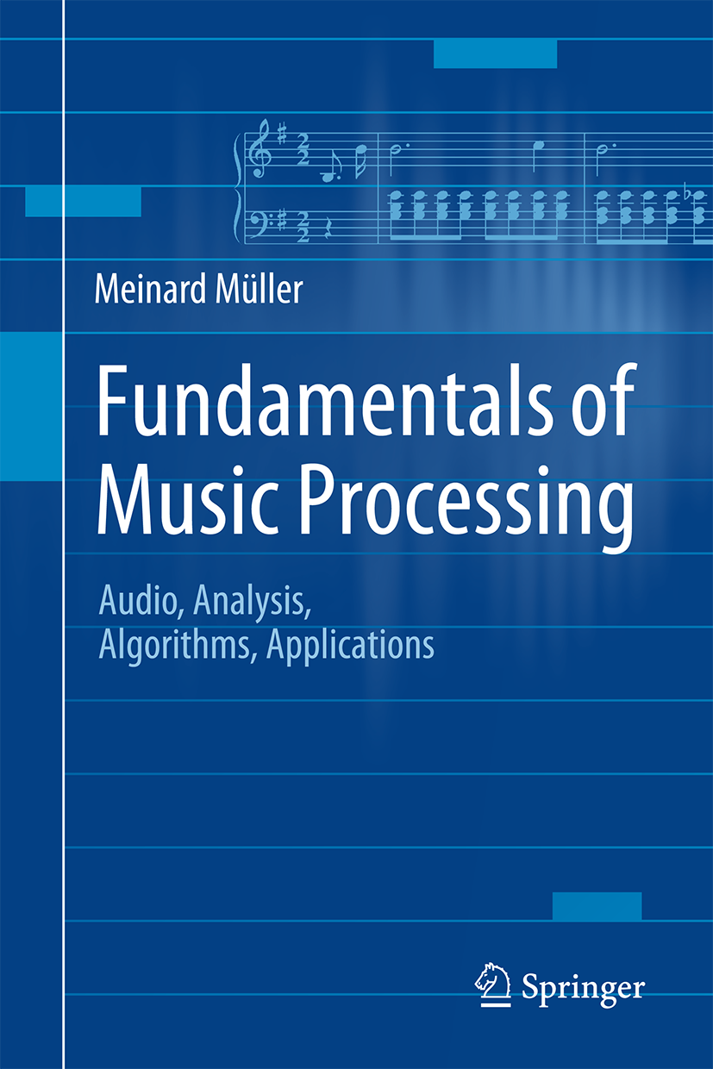
Book: Fundamentals of Music Processing
Meinard Müller
Fundamentals of Music Processing
Audio, Analysis, Algorithms, Applications
483 p., 249 illus., 30 illus. in color, hardcover
ISBN: 978-3-319-21944-8
Springer, 2015
Accompanying website:
www.music-processing.de

Slide 3
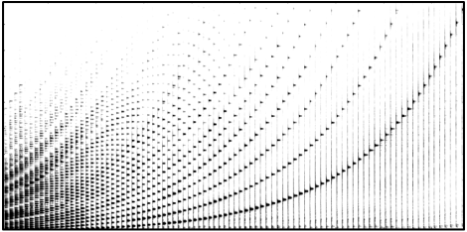
Chapter 2: Fourier Analysis of Signals
2.1 The Fourier Transform in a Nutshell
2.2 Signals and Signal Spaces
2.3 Fourier Transform
2.4 Discrete Fourier Transform (DFT)
2.5 Short-Time Fourier Transform (STFT)
2.6 Further Notes
Important technical terminology is covered in Chapter 2. In particular, we approach the Fourier transform—which is perhaps the most fundamental tool in signal processing—from various perspectives. For the reader who is more interested in the musical aspects of the book, Section 2.1 provides a summary of the most important facts on the Fourier transform. In particular, the notion of a spectrogram, which yields a time–frequency representation of an audio signal, is introduced. The remainder of the chapter treats the Fourier transform in greater mathematical depth and also includes the fast Fourier transform (FFT)—an algorithm of great beauty and high practical relevance.

Slide 4
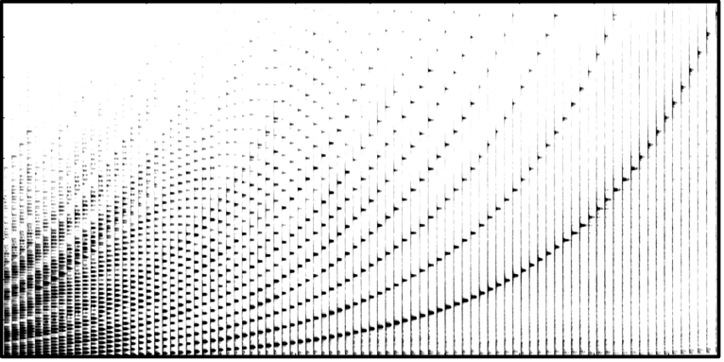
2 Fourier Analysis of Signals
Teaser

Slide 5
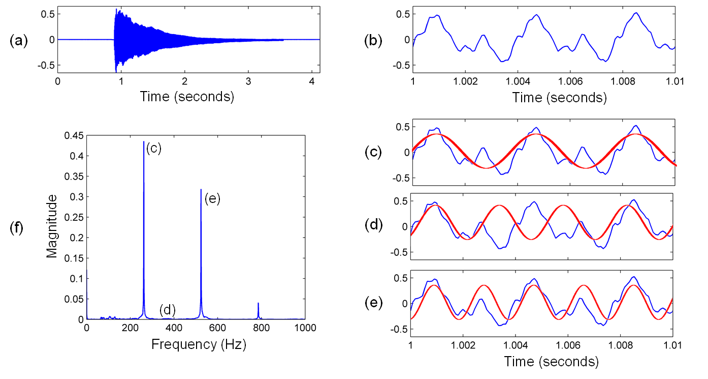
2.1 The Fourier Transform in a Nutshell
Fig. 2.1

Slide 6
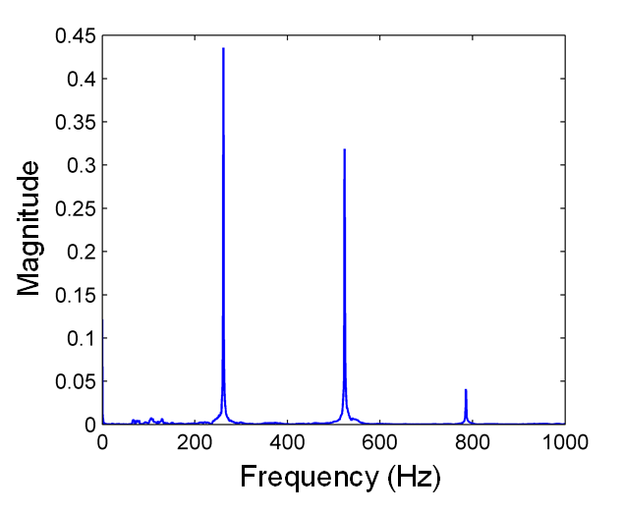
2.1 The Fourier Transform in a Nutshell
Fig. 2.1
Time (seconds)
Time (seconds)

Slide 7
2.1 The Fourier Transform in a Nutshell
Fig. 2.1
Time (seconds)
Time (seconds)

Slide 8
2.1 The Fourier Transform in a Nutshell
Fig. 2.1
Time (seconds)
Time (seconds)

Slide 9
2.1 The Fourier Transform in a Nutshell
Fig. 2.1
Time (seconds)
Time (seconds)

Slide 10
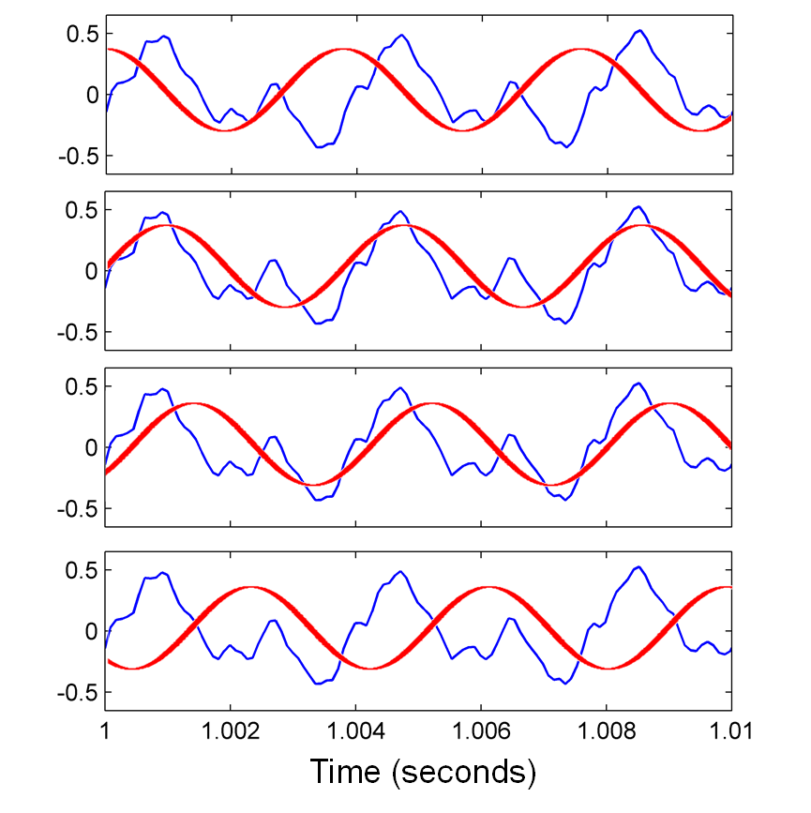
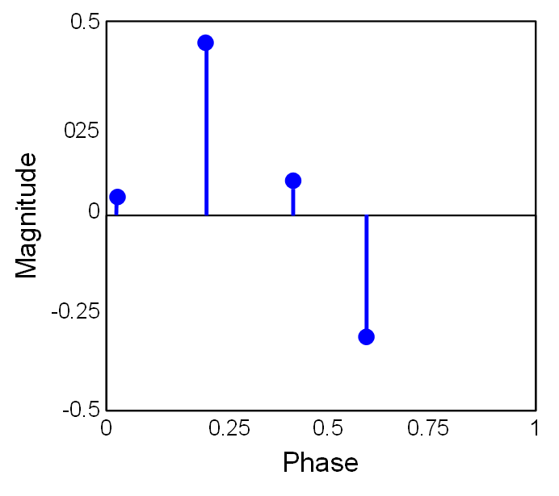
2.1 The Fourier Transform in a Nutshell
Fig. 2.2
(a)
(b)
(b)
(a)
(c)
(c)
(d)
(d)

Slide 11
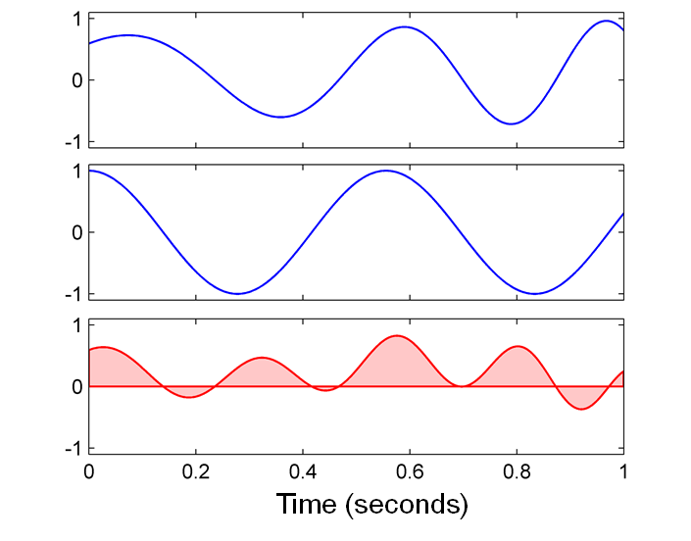
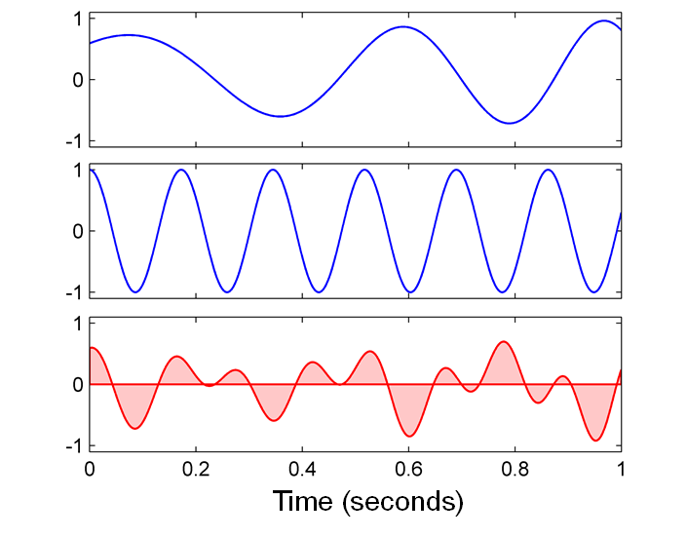
2.1 The Fourier Transform in a Nutshell
Fig. 2.3

Slide 12
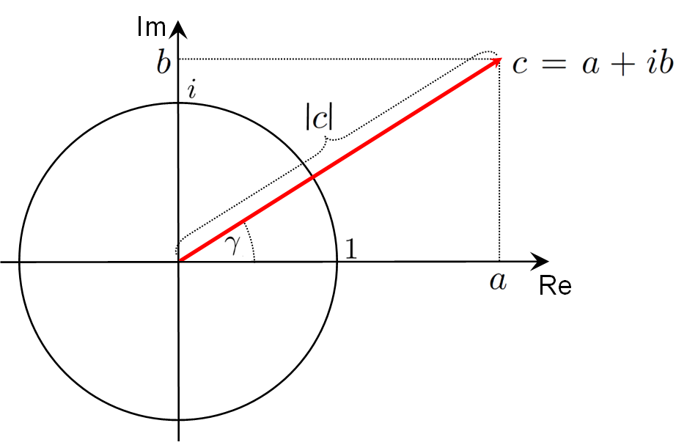
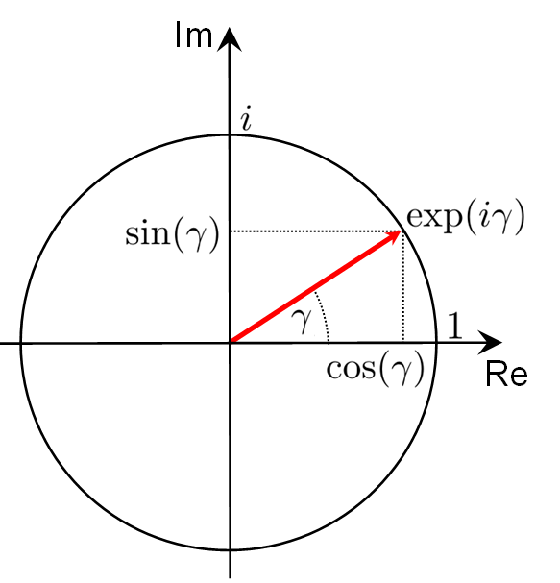
2.1 The Fourier Transform in a Nutshell
Fig. 2.4

Slide 13
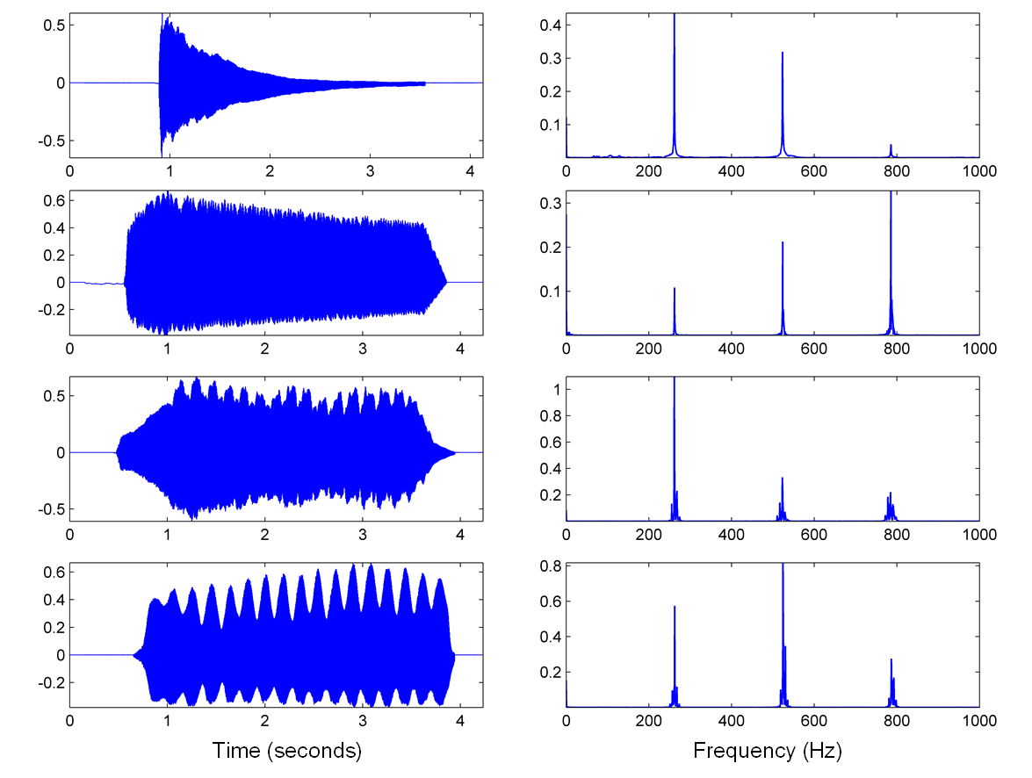
2.1 The Fourier Transform in a Nutshell
Fig. 2.5

Slide 14
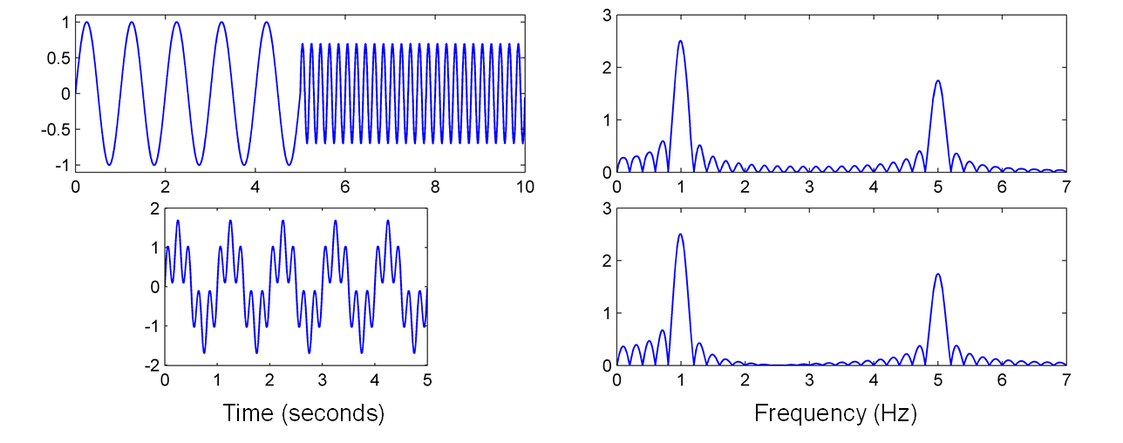
2.1 The Fourier Transform in a Nutshell
Fig. 2.6

Slide 15
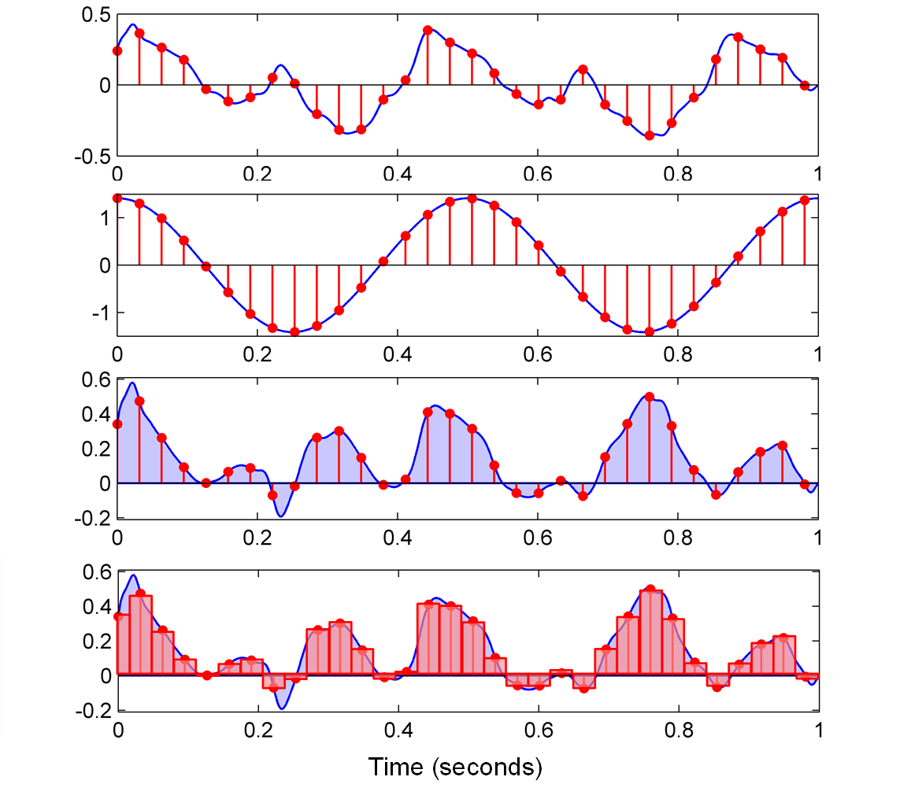
2.1 The Fourier Transform in a Nutshell
Fig. 2.7

Slide 16
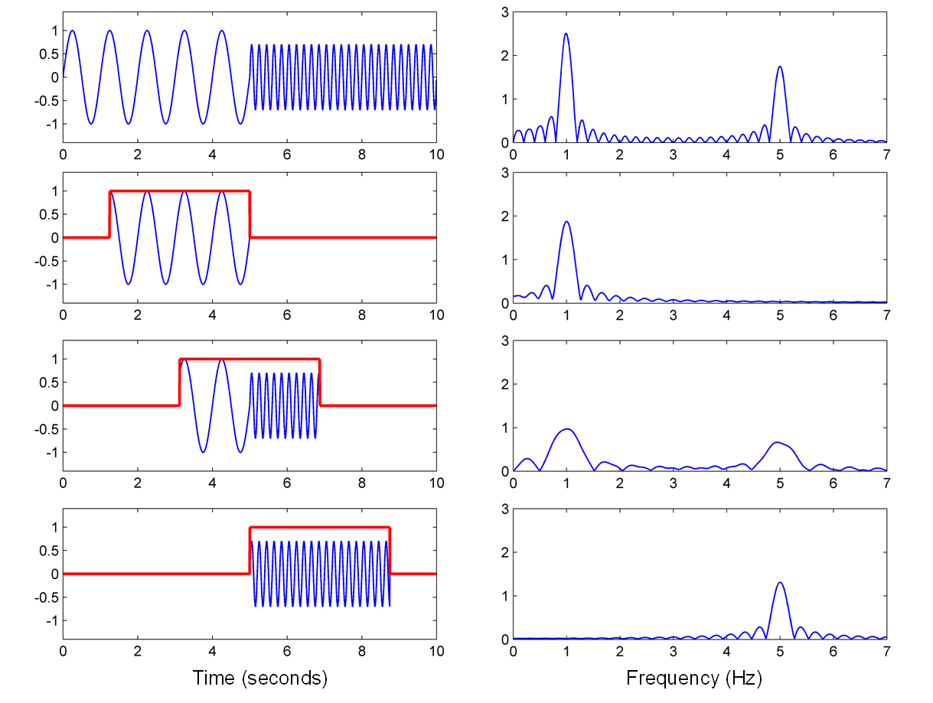
2.1 The Fourier Transform in a Nutshell
Fig. 2.8

Slide 17
2.1 The Fourier Transform in a Nutshell
Fig. 2.8
Time (seconds)
Frequency (Hz)

Slide 18
2.1 The Fourier Transform in a Nutshell
Fig. 2.8
Time (seconds)
Frequency (Hz)

Slide 19
2.1 The Fourier Transform in a Nutshell
Fig. 2.8
Time (seconds)
Frequency (Hz)

Slide 20
2.1 The Fourier Transform in a Nutshell
Fig. 2.8
Time (seconds)
Frequency (Hz)

Slide 21
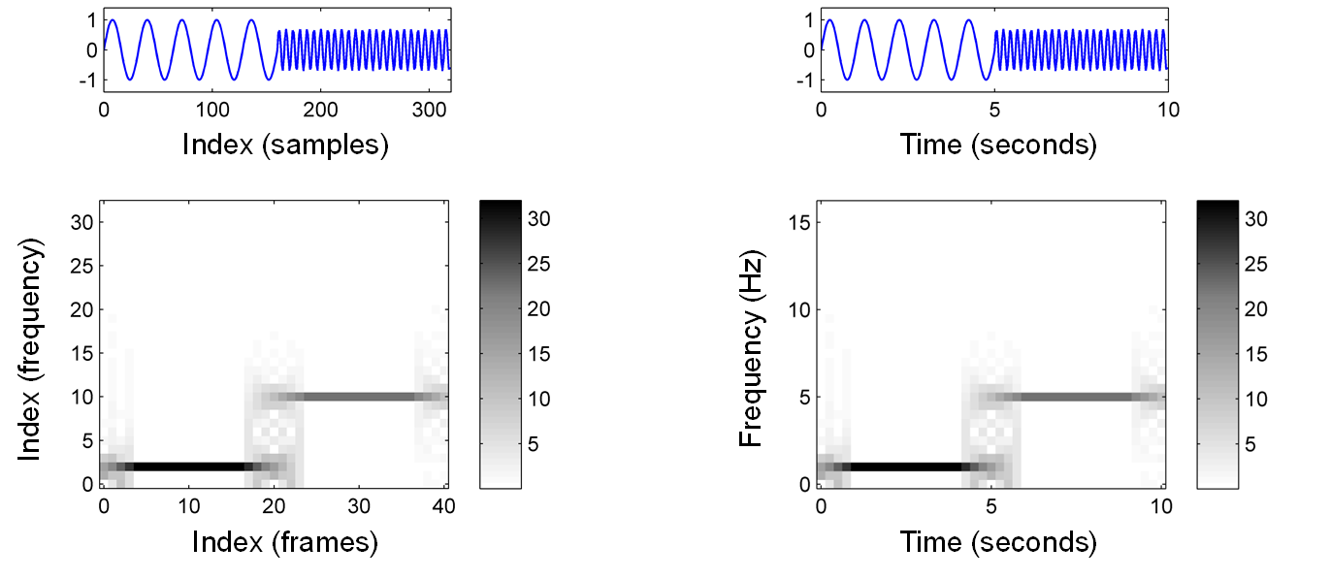
2.1 The Fourier Transform in a Nutshell
Fig. 2.9

Slide 22
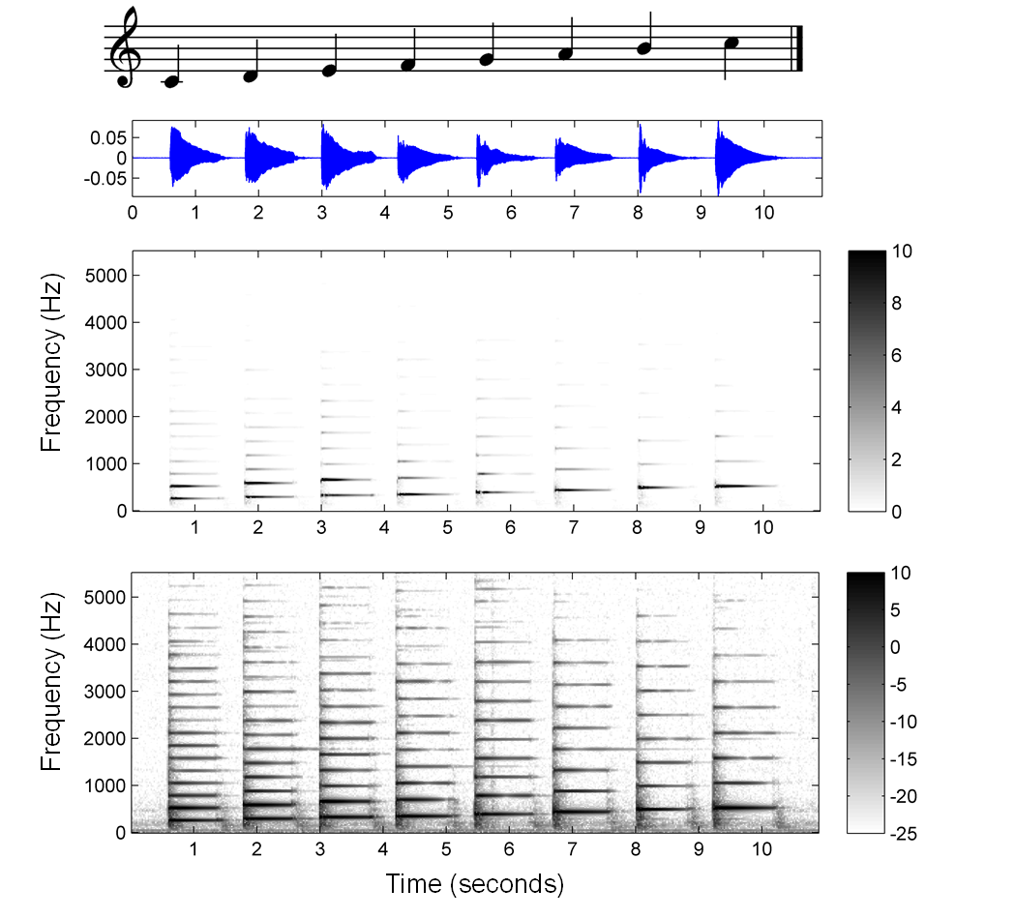
2.1 The Fourier Transform in a Nutshell
Fig. 2.10

Slide 23
2.1 The Fourier Transform in a Nutshell
Fig. 2.10
Frequency (Hz)
Time (seconds)

Slide 24
2.1 The Fourier Transform in a Nutshell
Fig. 2.10
Frequency (Hz)
Time (seconds)

Slide 25
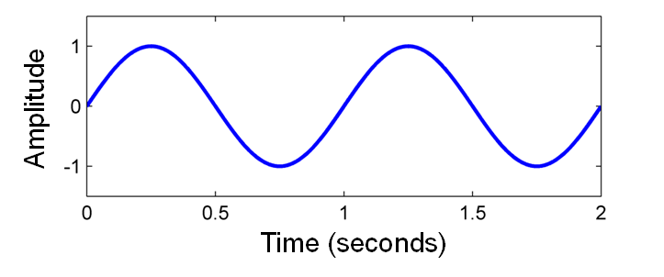
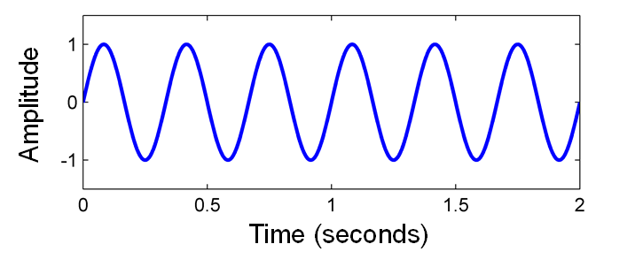
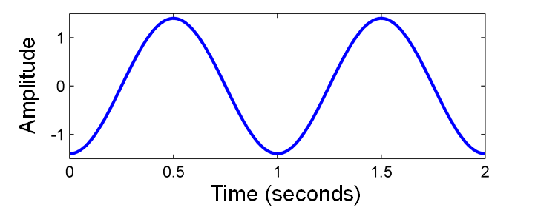
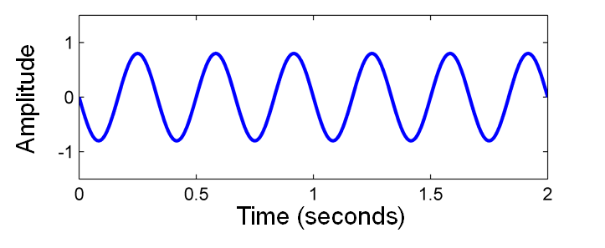
2.2 Signals and Signal Spaces
Fig. 2.11

Slide 26
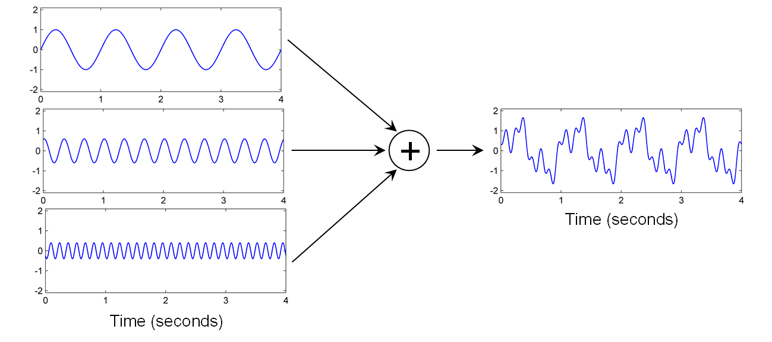
2.2 Signals and Signal Spaces
Fig. 2.12

Slide 27
2.2 Signals and Signal Spaces
Fig. 2.13

Slide 28
2.2 Signals and Signal Spaces
Fig. 2.13
Amplitude
Time (seconds)

Slide 29
2.2 Signals and Signal Spaces
Fig. 2.13
Amplitude
Sampling period
Time (seconds)

Slide 30
2.2 Signals and Signal Spaces
Fig. 2.13
Amplitude
Sampling period
Time (seconds)

Slide 31
2.2 Signals and Signal Spaces
Fig. 2.13
Amplitude
Quantization
step size
Sampling period
Time (seconds)

Slide 32
2.2 Signals and Signal Spaces
Fig. 2.13
Amplitude
Quantization
step size
Sampling period
Time (seconds)

Slide 33
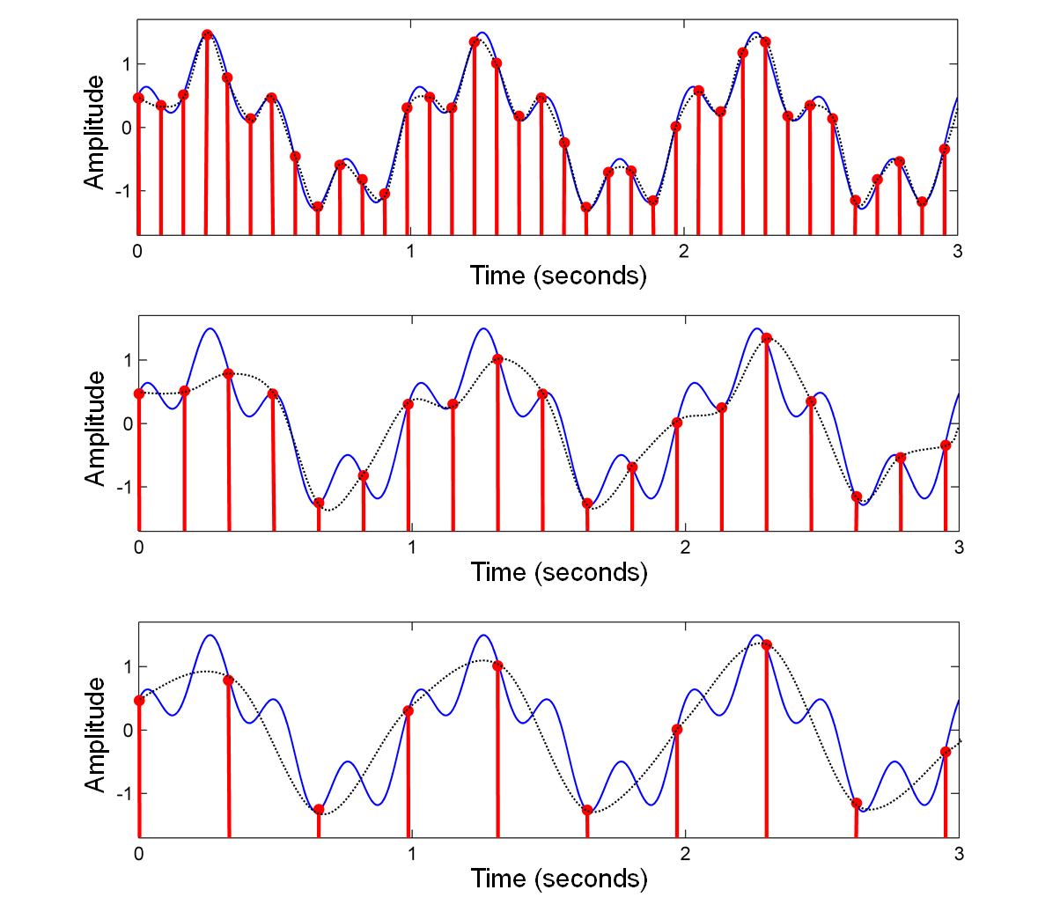
2.2 Signals and Signal Spaces
Fig. 2.14

Slide 34
2.2 Signals and Signal Spaces
Fig. 2.14
Amplitude
Time (seconds)

Slide 35
2.2 Signals and Signal Spaces
Fig. 2.14
Amplitude
Time (seconds)

Slide 36
2.2 Signals and Signal Spaces
Fig. 2.14
Amplitude
Time (seconds)

Slide 37
2.2 Signals and Signal Spaces
Fig. 2.14
Amplitude
Time (seconds)

Slide 38
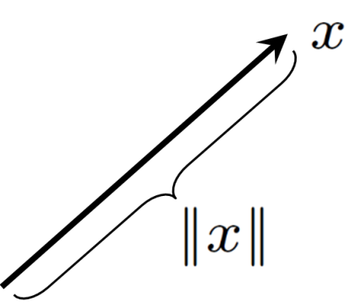
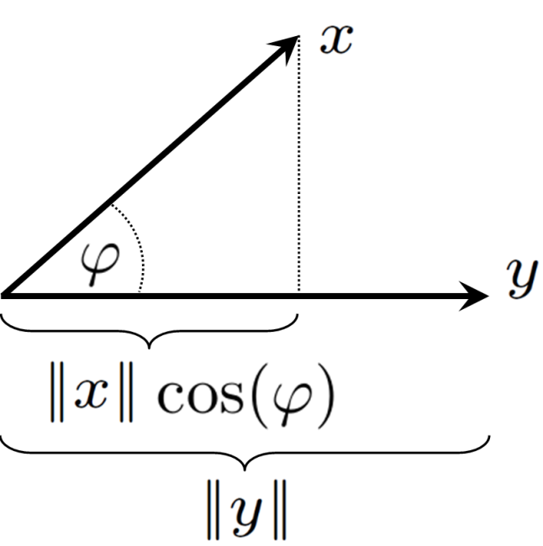
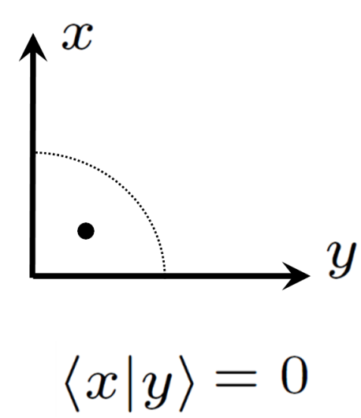
2.2 Signals and Signal Spaces
Fig. 2.15

Slide 39
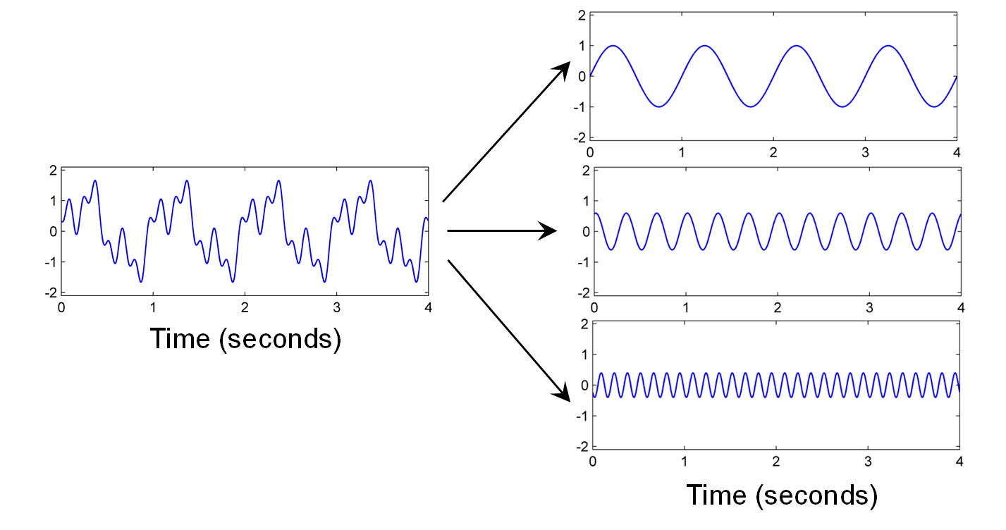
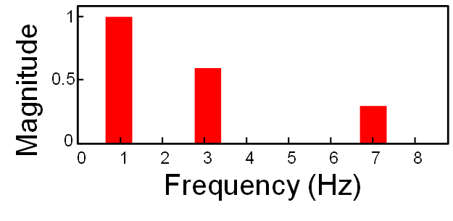
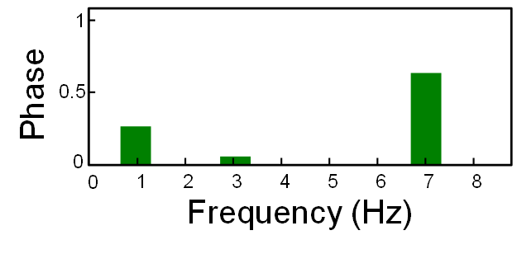
2.3 Fourier Transform
Fig. 2.16

Slide 40
2.3 Fourier Transform
Fig. 2.17

Slide 41
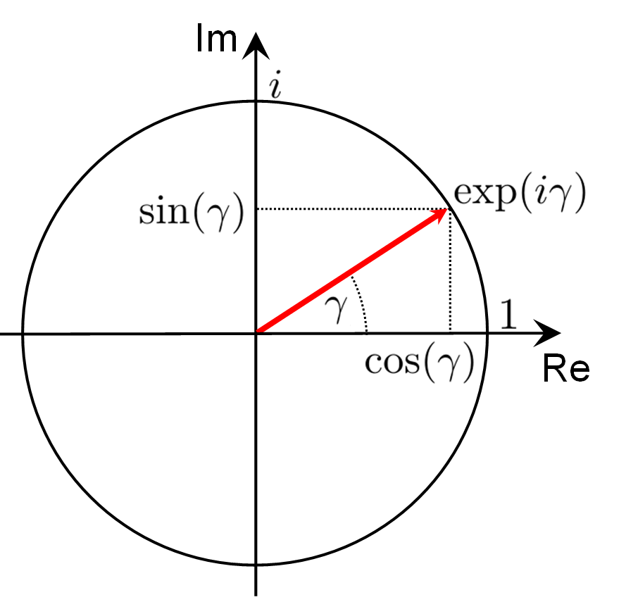
2.3 Fourier Transform
Fig. 2.17

Slide 42
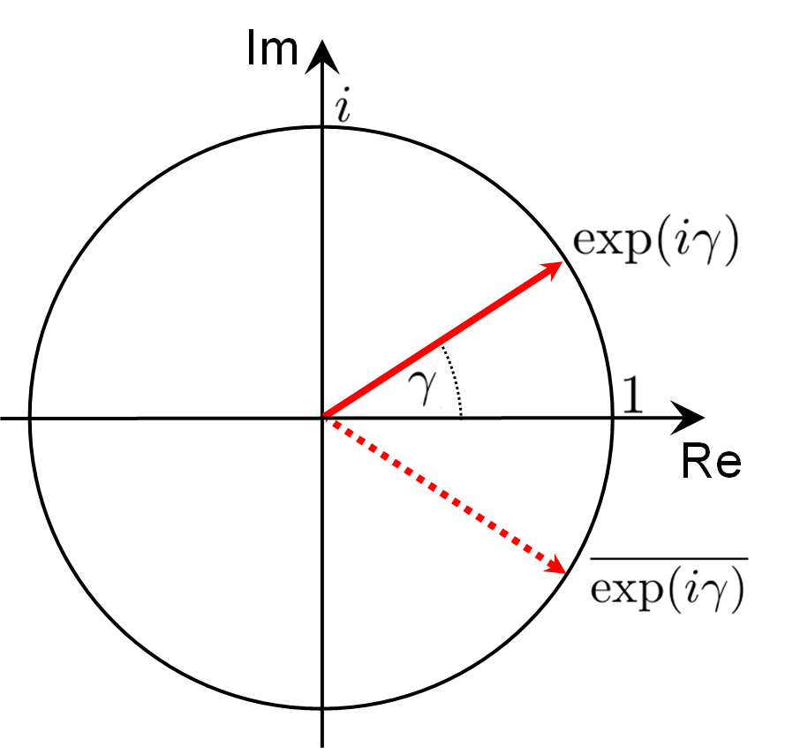
2.3 Fourier Transform
Fig. 2.17

Slide 43
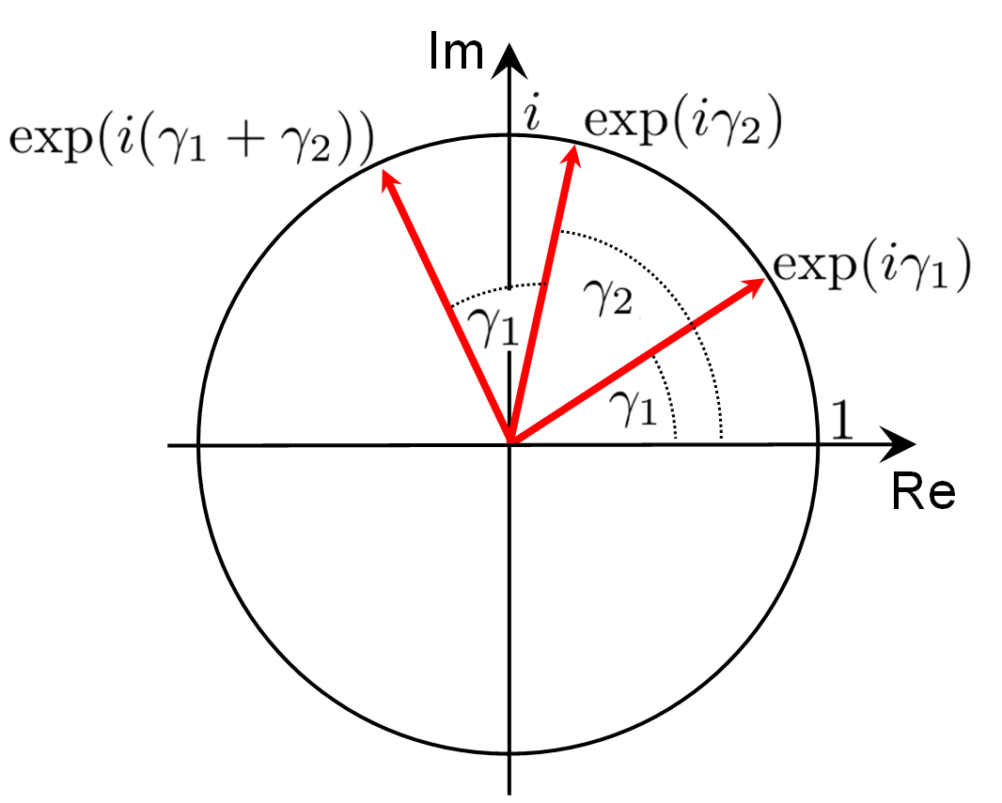
2.3 Fourier Transform
Fig. 2.17

Slide 44
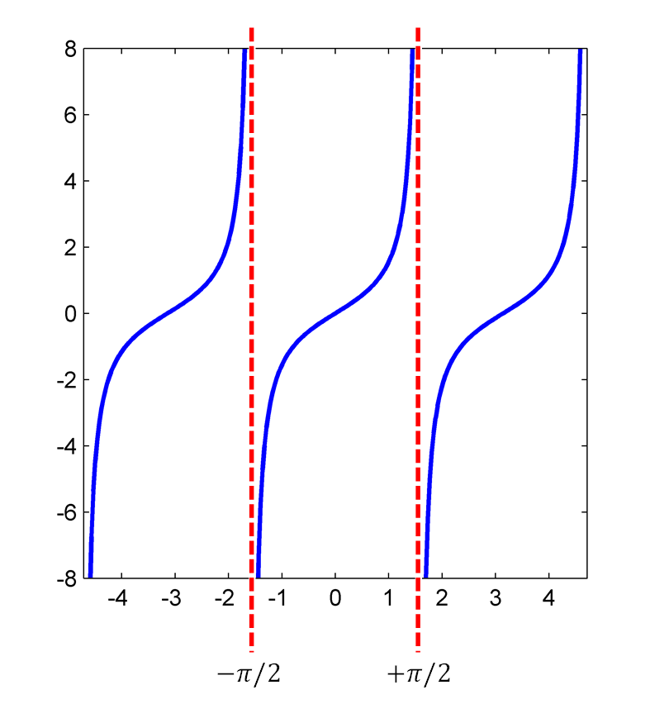
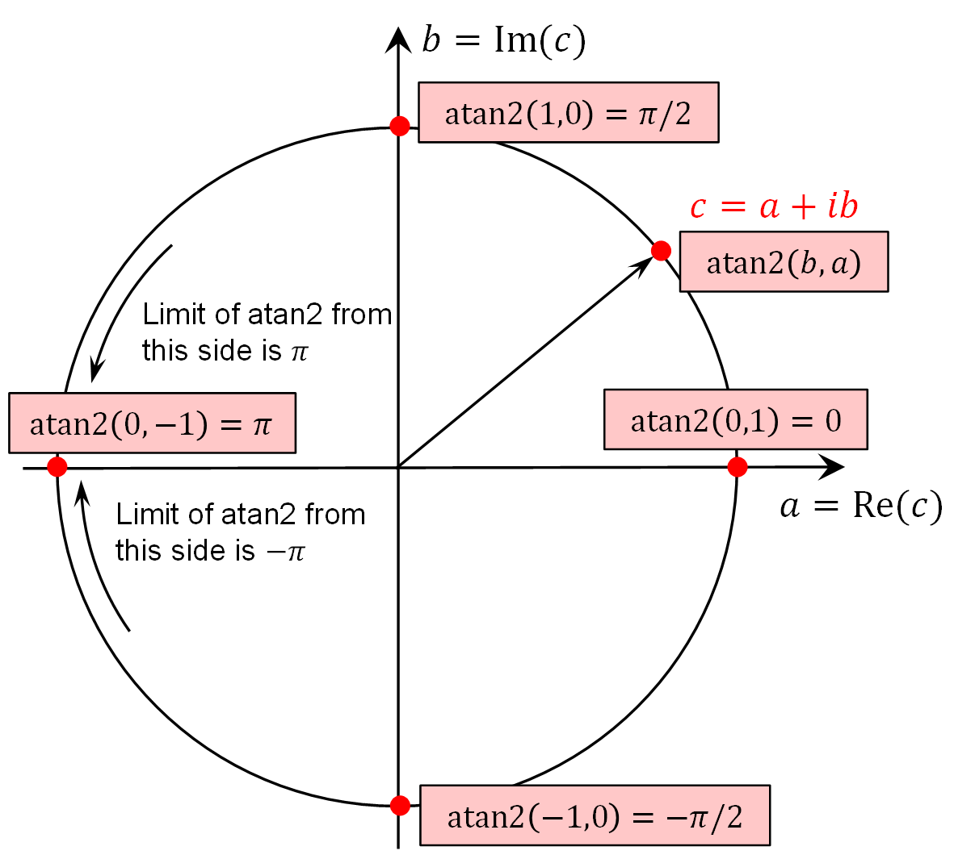
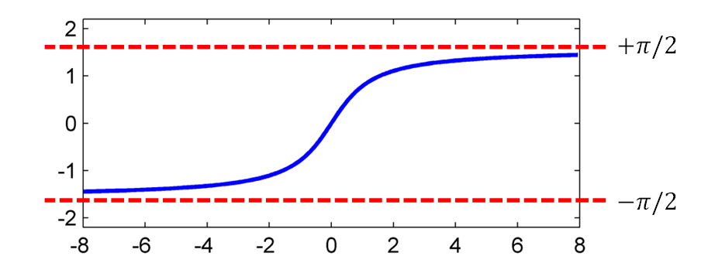
2.3 Fourier Transform
Fig. 2.18

Slide 45
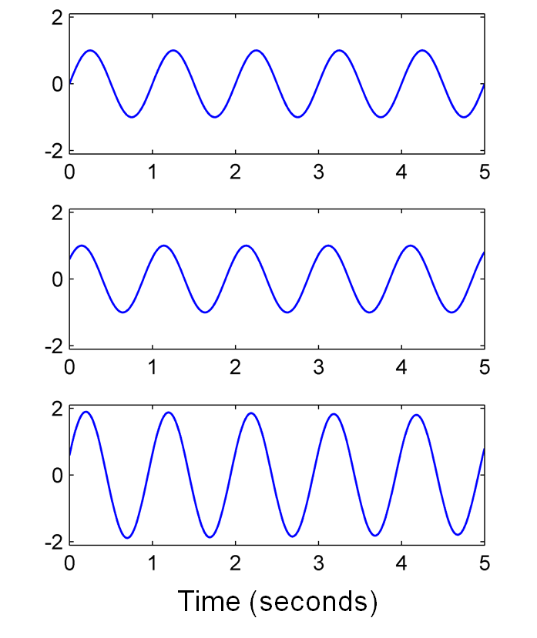
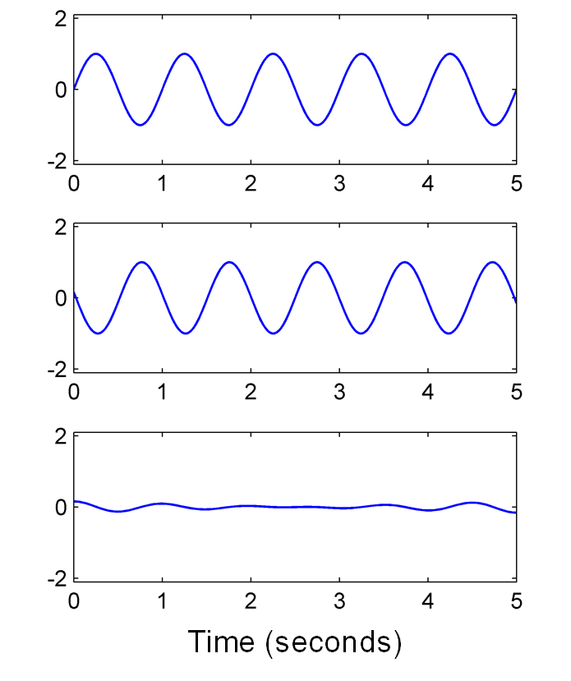
2.3 Fourier Transform
Fig. 2.19

Slide 46
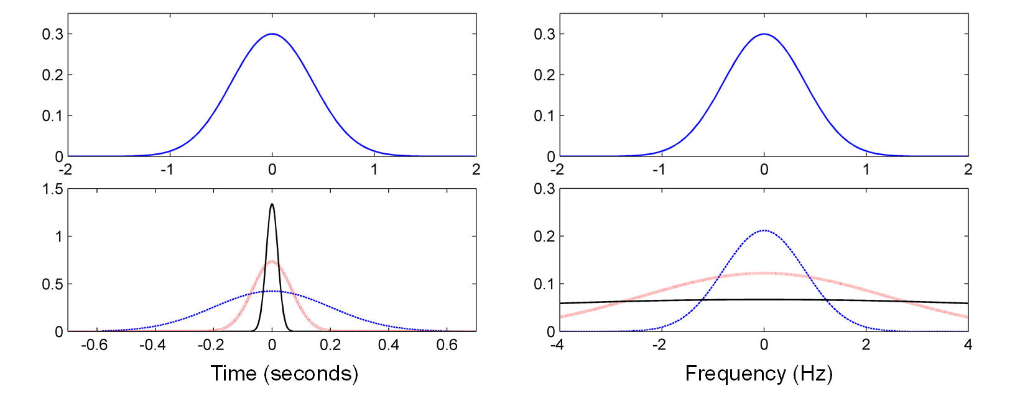
2.3 Fourier Transform
Fig. 2.20

Slide 47
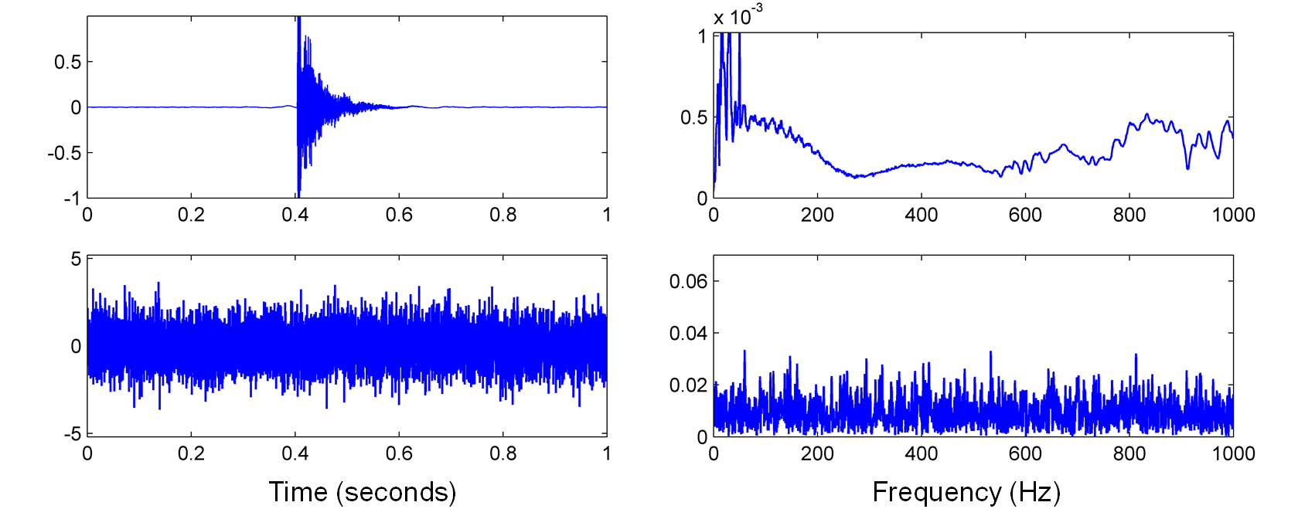
2.3 Fourier Transform
Fig. 2.21

Slide 48
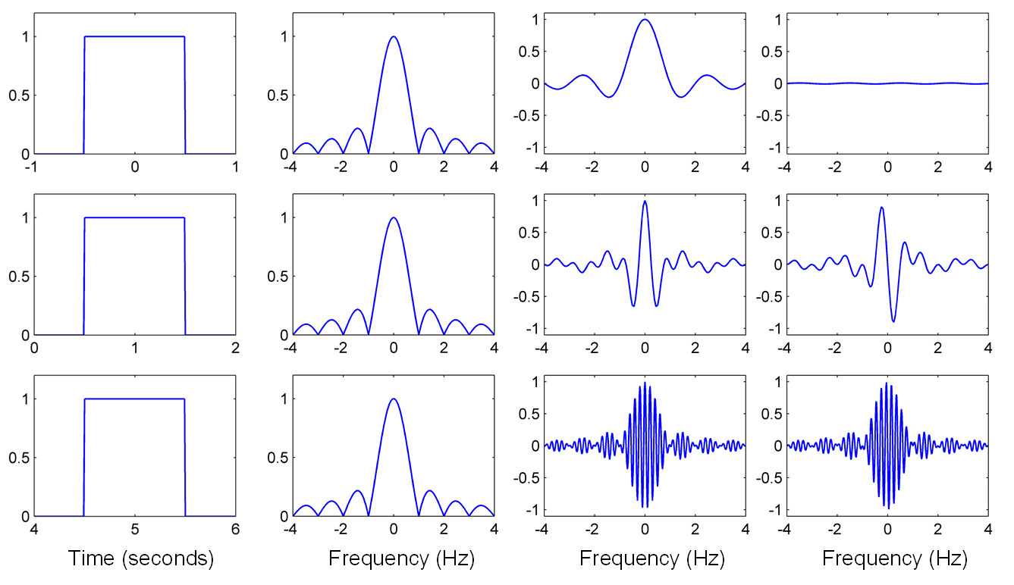
2.3 Fourier Transform
Fig. 2.22

Slide 49
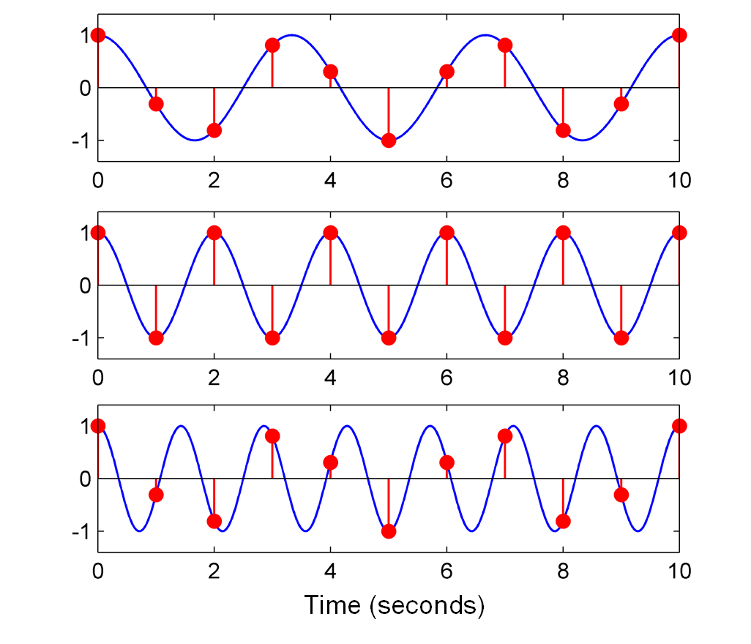
2.3 Fourier Transform
Fig. 2.23

Slide 50
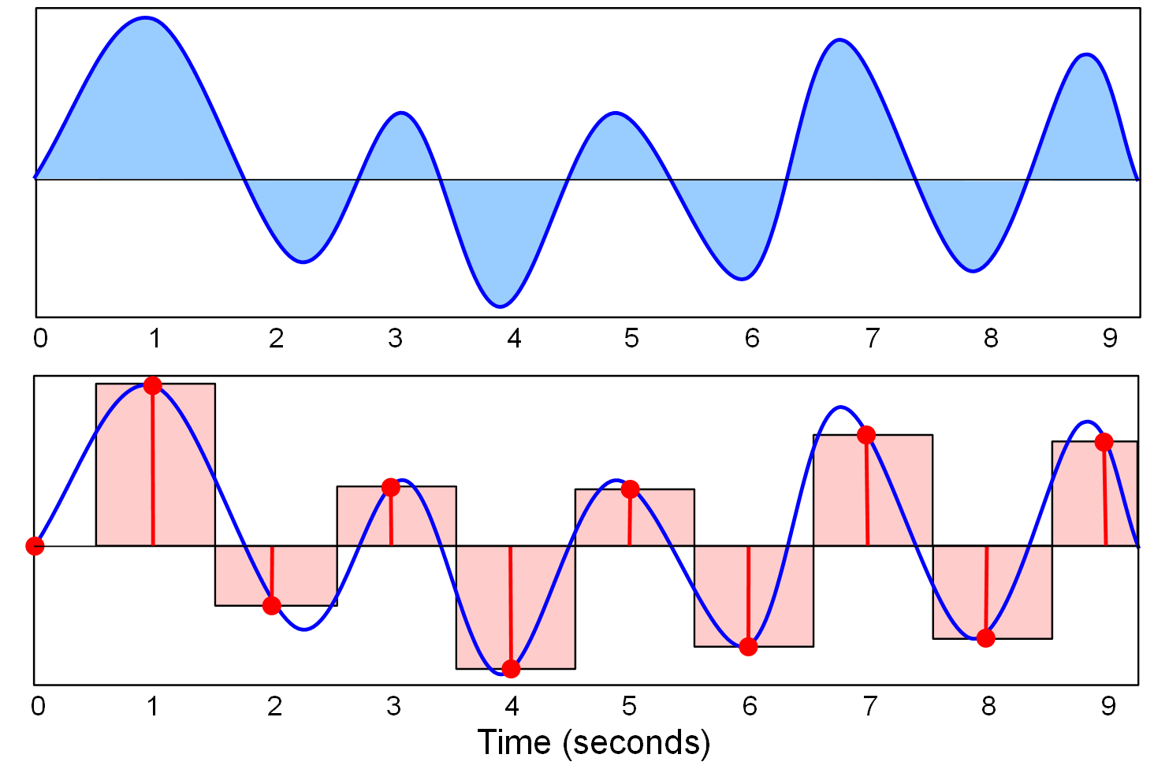
2.3 Fourier Transform
Fig. 2.24

Slide 51
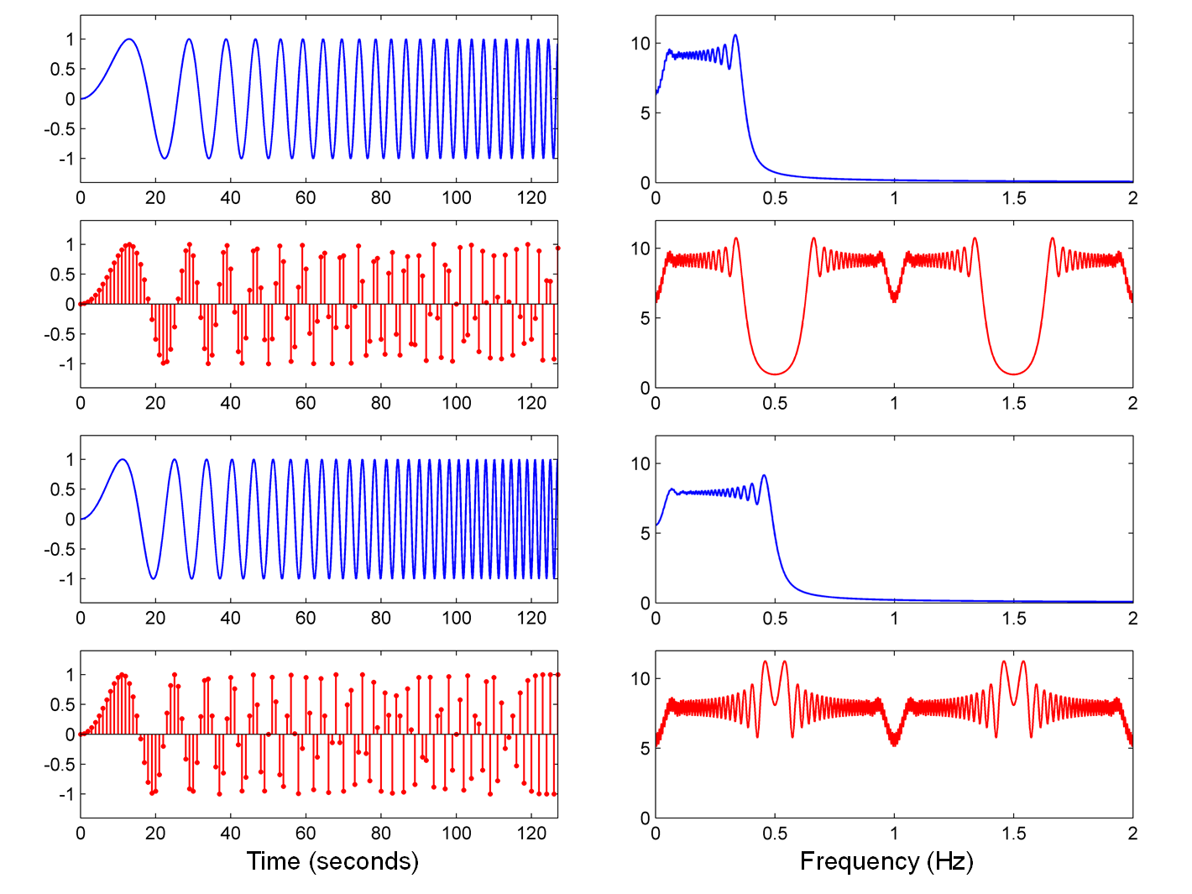
2.3 Fourier Transform
Fig. 2.25

Slide 52
2.3 Fourier Transform
Fig. 2.25
Time (seconds)
Frequency (Hz)
Time (seconds)
Frequency (Hz)

Slide 53
2.3 Fourier Transform
Fig. 2.25
Time (seconds)
Frequency (Hz)
Time (seconds)
Frequency (Hz)

Slide 54
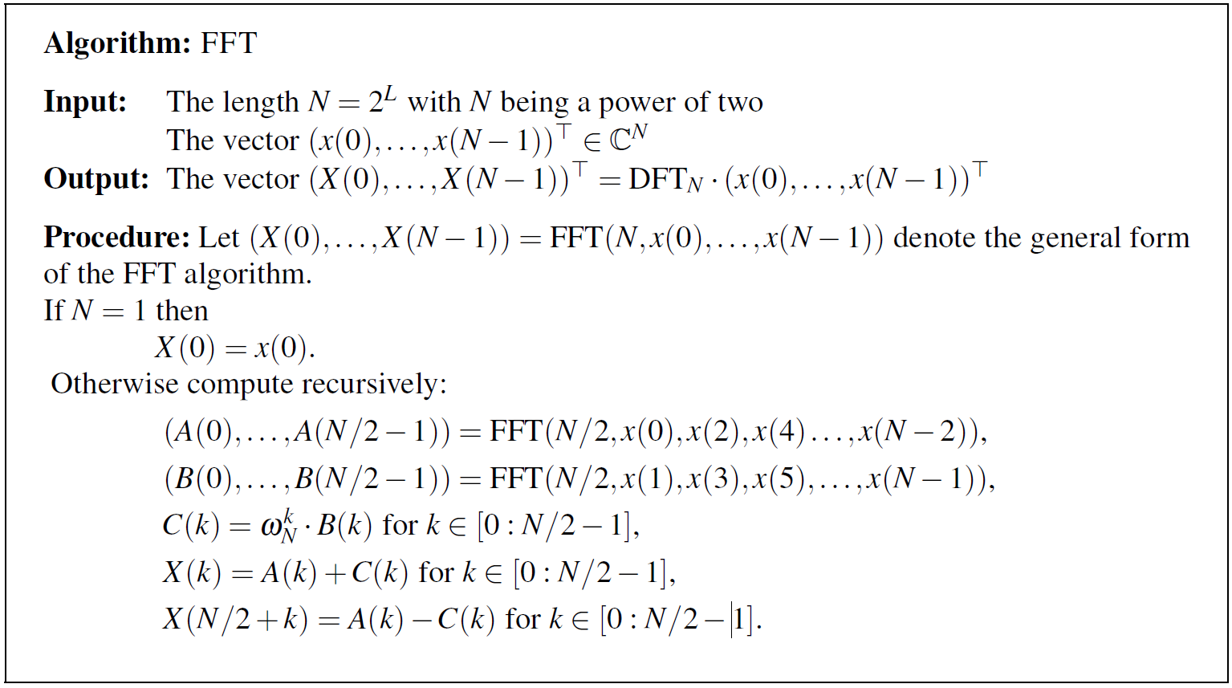
2.4 Discrete Fourier Transform (DFT)
Table 2.1

Slide 55
2.4 Discrete Fourier Transform (DFT)
Fig. 2.26

Slide 56
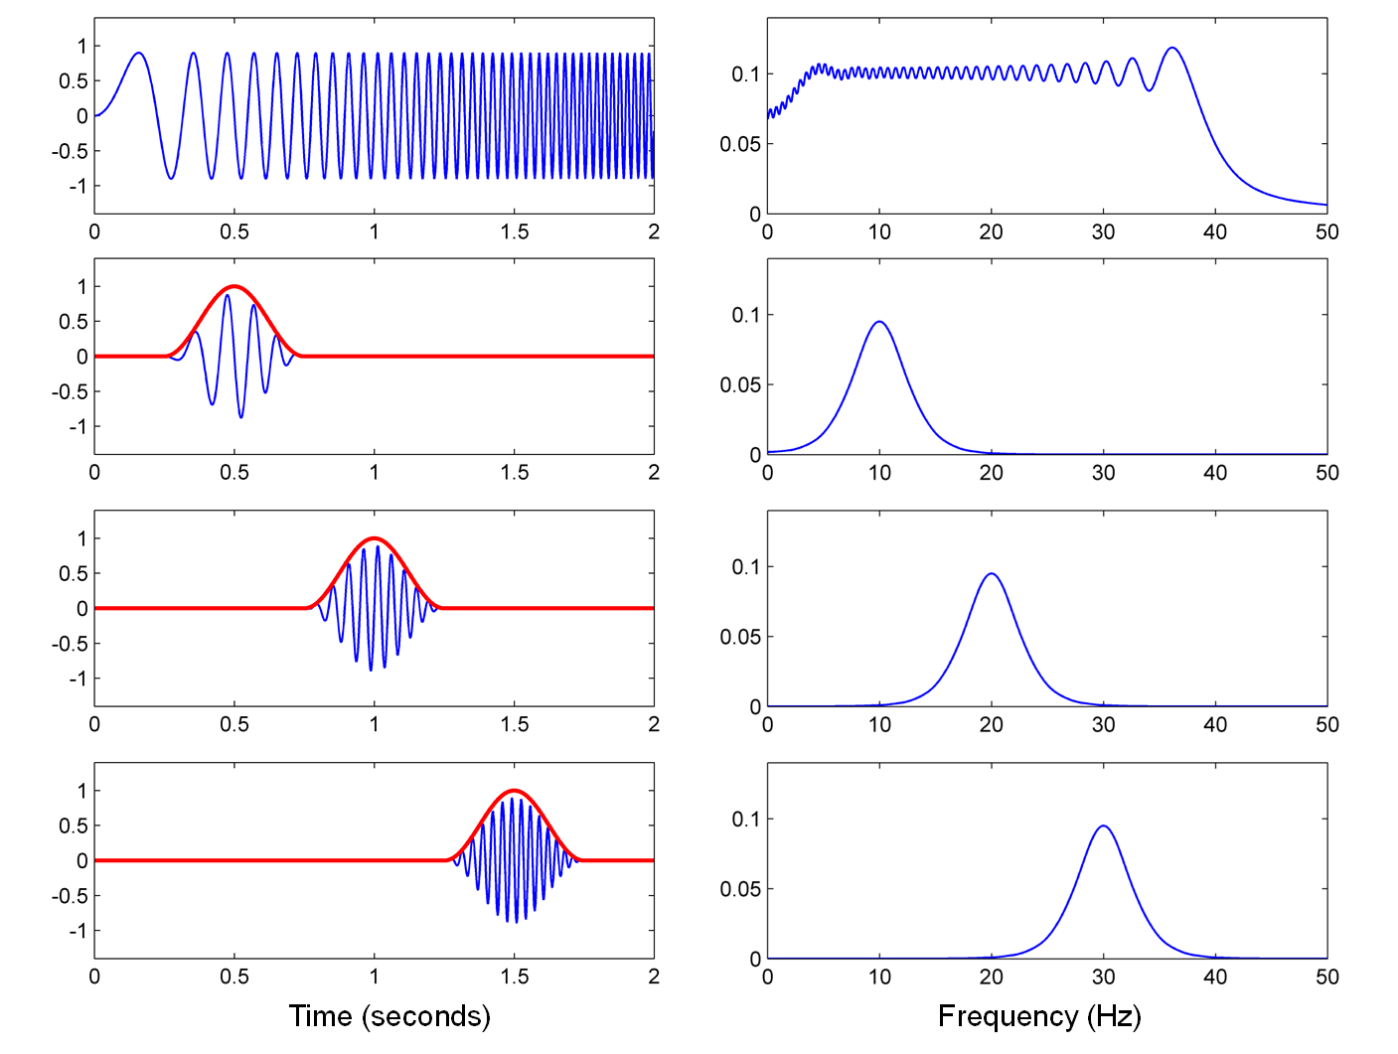
2.5 Short-Time Fourier Transform (STFT)
Fig. 2.27

Slide 57
2.5 Short-Time Fourier Transform (STFT)
Fig. 2.27
Time (seconds)
Frequency (Hz)

Slide 58
2.5 Short-Time Fourier Transform (STFT)
Fig. 2.27
Time (seconds)
Frequency (Hz)

Slide 59
2.5 Short-Time Fourier Transform (STFT)
Fig. 2.27
Time (seconds)
Frequency (Hz)

Slide 60
2.5 Short-Time Fourier Transform (STFT)
Fig. 2.27
Time (seconds)
Frequency (Hz)

Slide 61
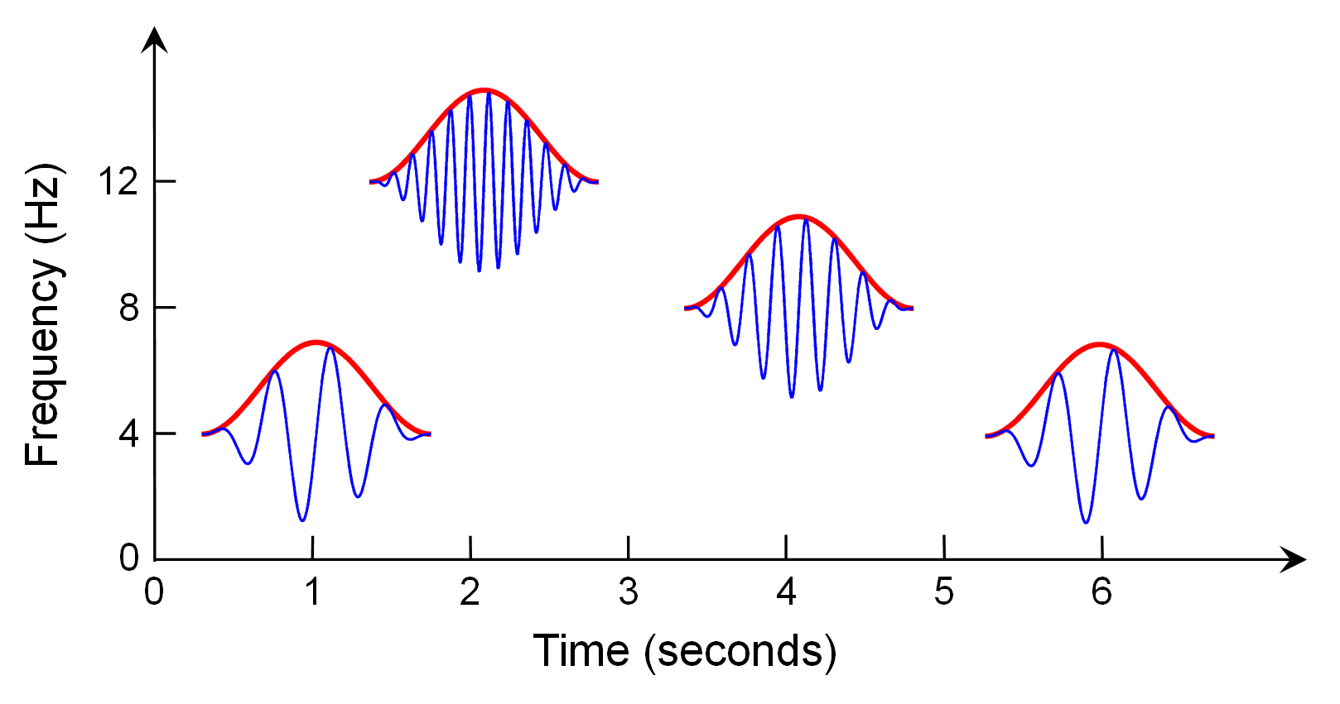
2.5 Short-Time Fourier Transform (STFT)
Fig. 2.28

Slide 62
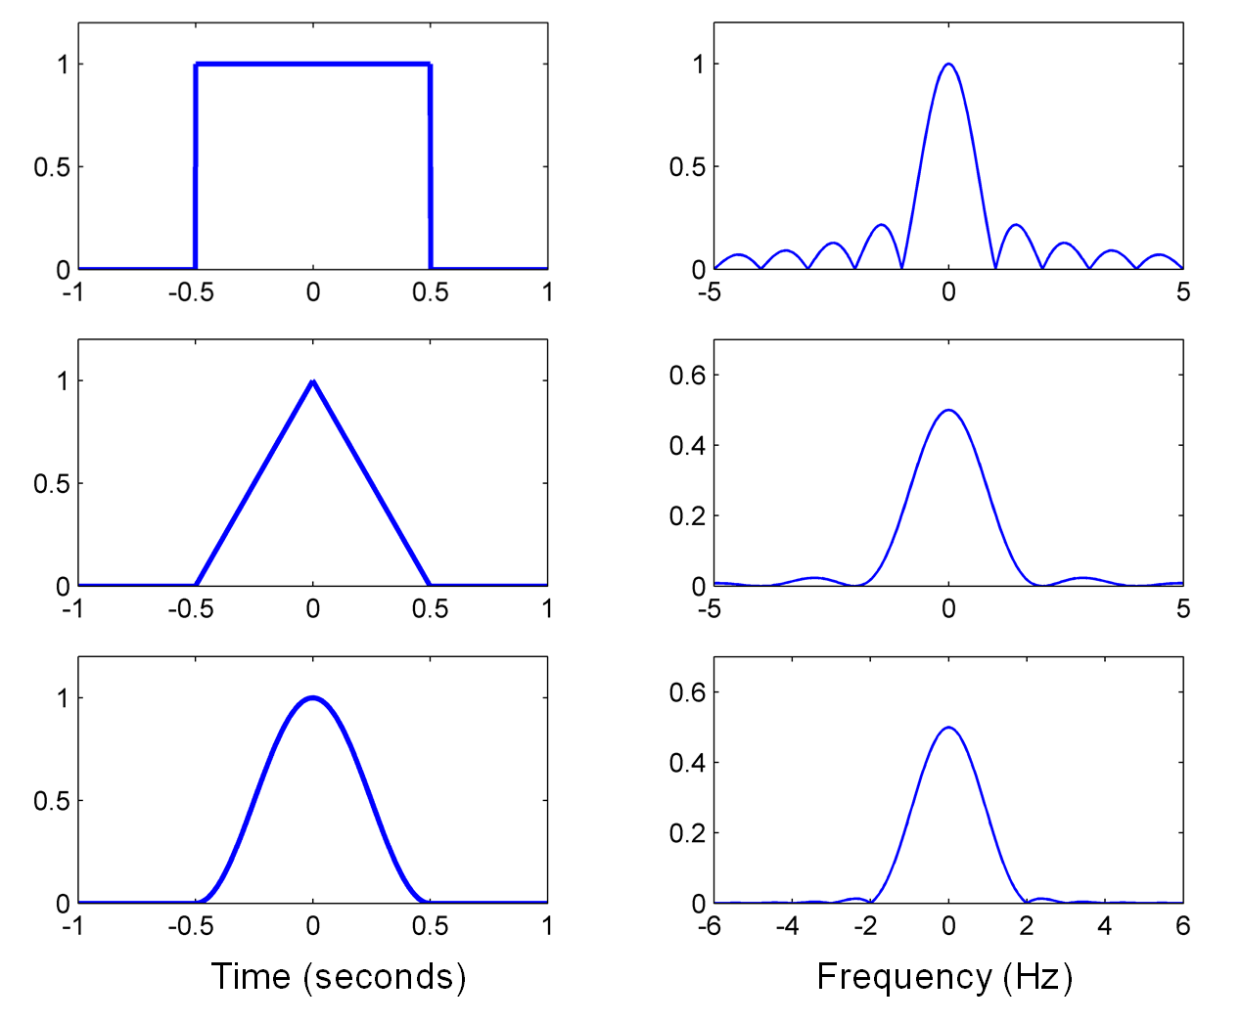
2.5 Short-Time Fourier Transform (STFT)
Fig. 2.29

Slide 63
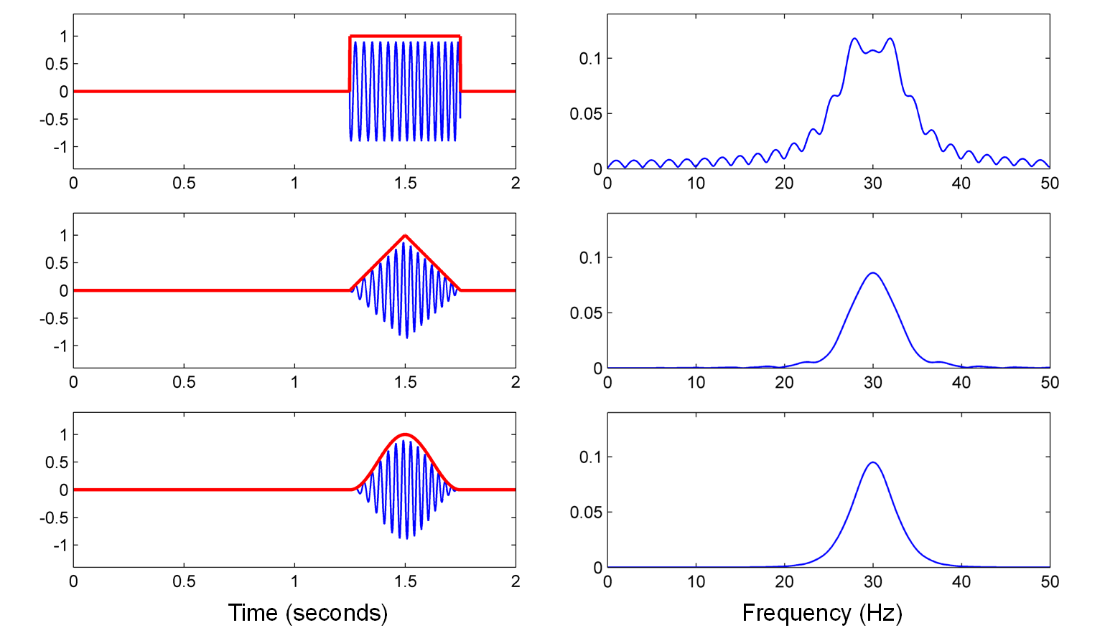
2.5 Short-Time Fourier Transform (STFT)
Fig. 2.30

Slide 64
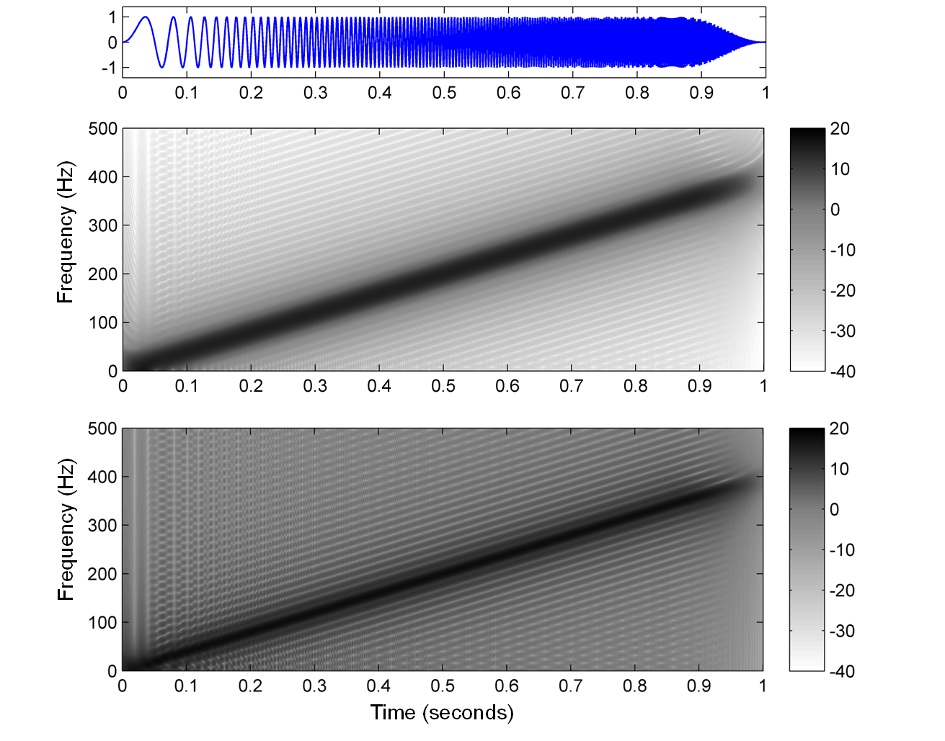
2.5 Short-Time Fourier Transform (STFT)
Fig. 2.31

Slide 65
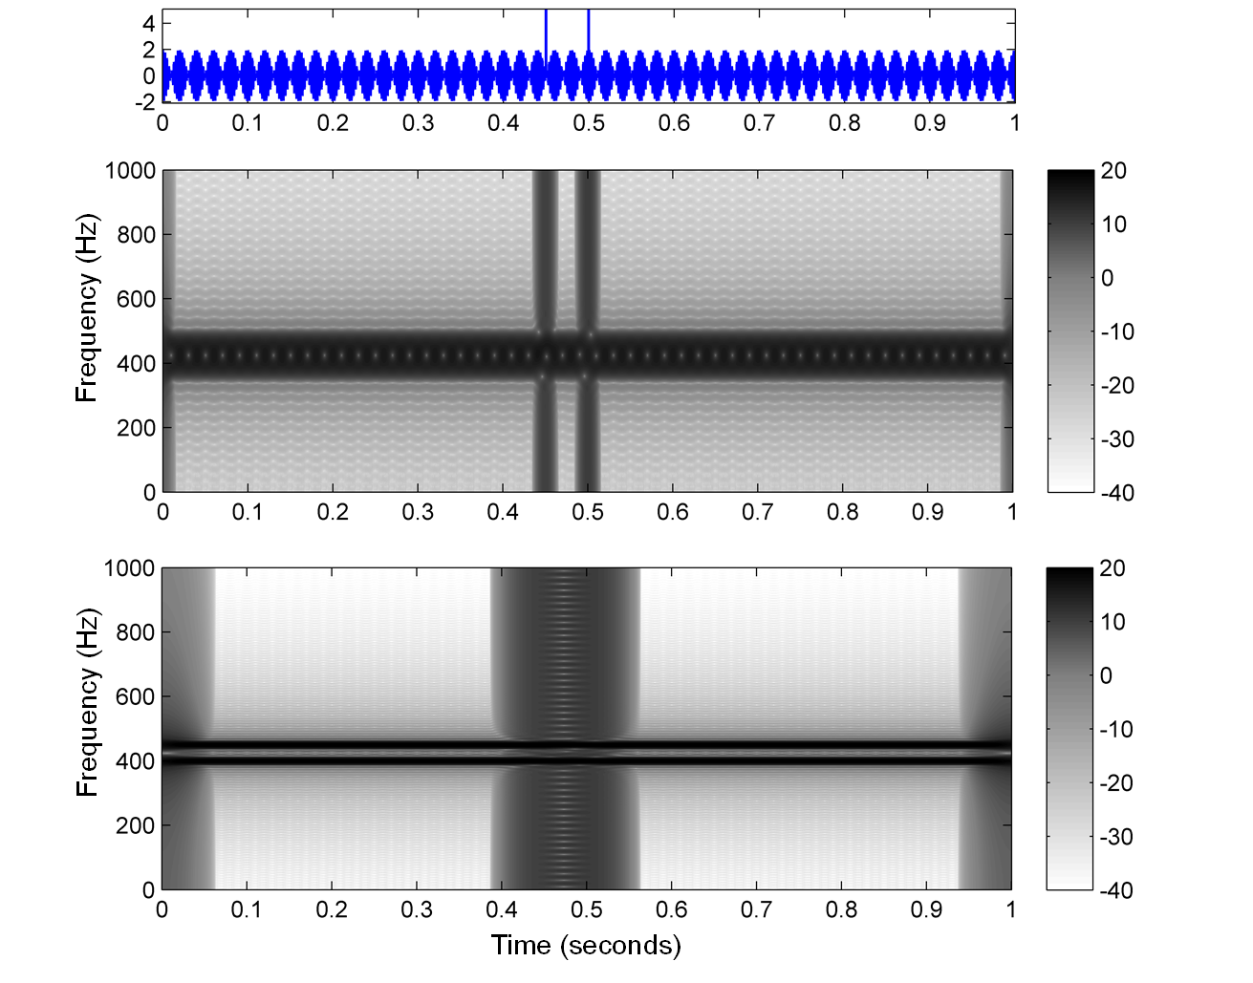
2.5 Short-Time Fourier Transform (STFT)
Fig. 2.32

Slide 66
2.5 Short-Time Fourier Transform (STFT)
Fig. 2.33

Slide 67
2.6 Further Notes
Table 2.2

