Slide 1
Fundamentals of Music Processing
Chapter 4: Music Structure Analysis
Meinard Müller
International Audio Laboratories Erlangen
www.music-processing.de

Slide 2
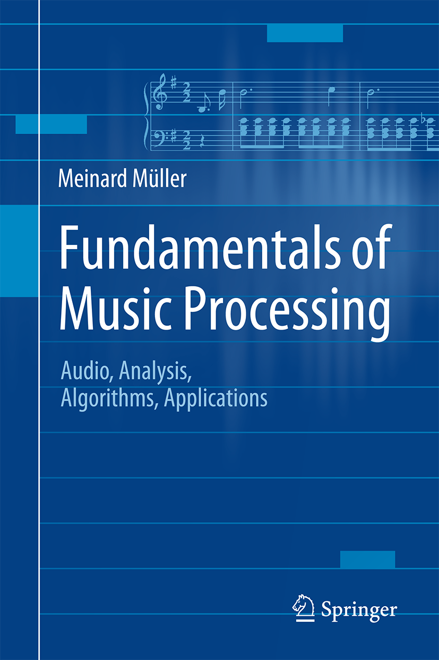
Book: Fundamentals of Music Processing
Meinard Müller
Fundamentals of Music Processing
Audio, Analysis, Algorithms, Applications
483 p., 249 illus., 30 illus. in color, hardcover
ISBN: 978-3-319-21944-8
Springer, 2015
Accompanying website:
www.music-processing.de

Slide 3
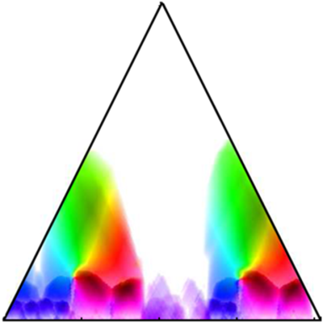
Chapter 4: Music Structure Analysis
4.1 General Principles
4.2 Self-Similarity Matrices
4.3 Audio Thumbnailing
4.4 Novelty-Based Segmentation
4.5 Evaluation
4.6 Further Notes
In Chapter 4, we address a central and well-researched area within MIR known as music structure analysis. Given a music recording, the objective is to identify important structural elements and to temporally segment the recording according to these elements. Within this scenario, we discuss fundamental segmentation principles based on repetitions, homogeneity, and novelty—principles that also apply to other types of multimedia beyond music. As an important technical tool, we study in detail the concept of self-similarity matrices and discuss their structural properties. Finally, we briefly touch the topic of evaluation, introducing the notions of precision, recall, and F-measure.

Slide 4
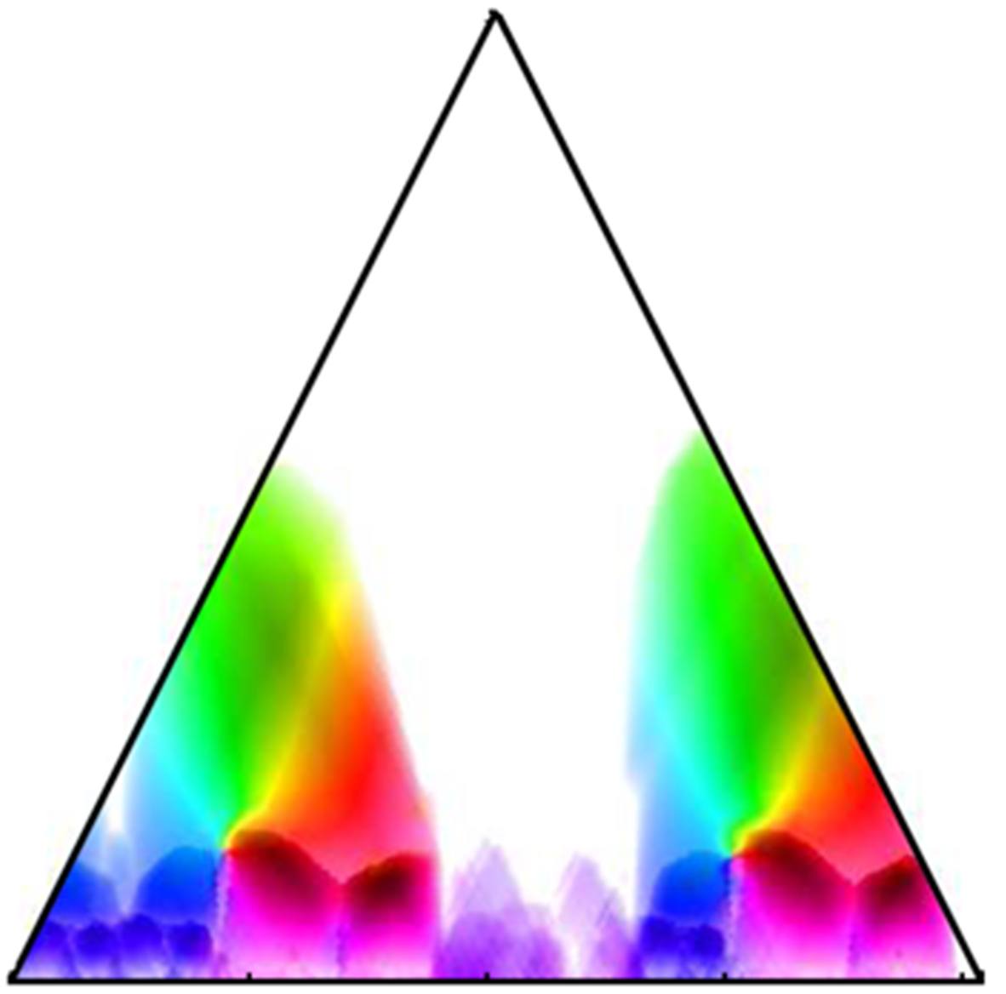
4 Music Structure Analysis
Teaser

Slide 5
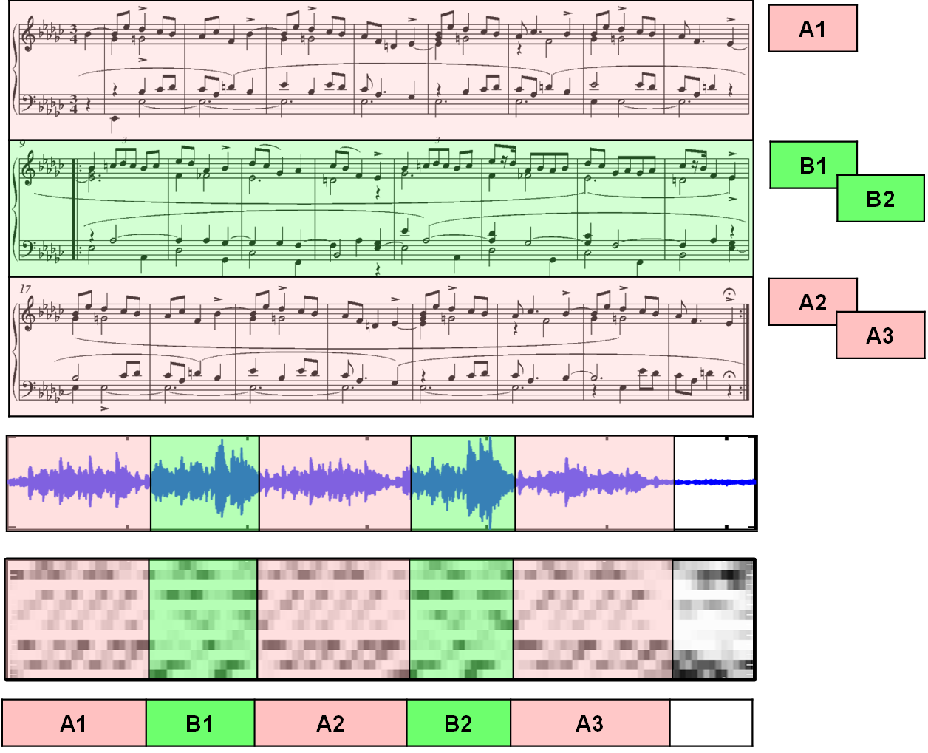
4 Music Structure Analysis
Fig. 4.1

Slide 6
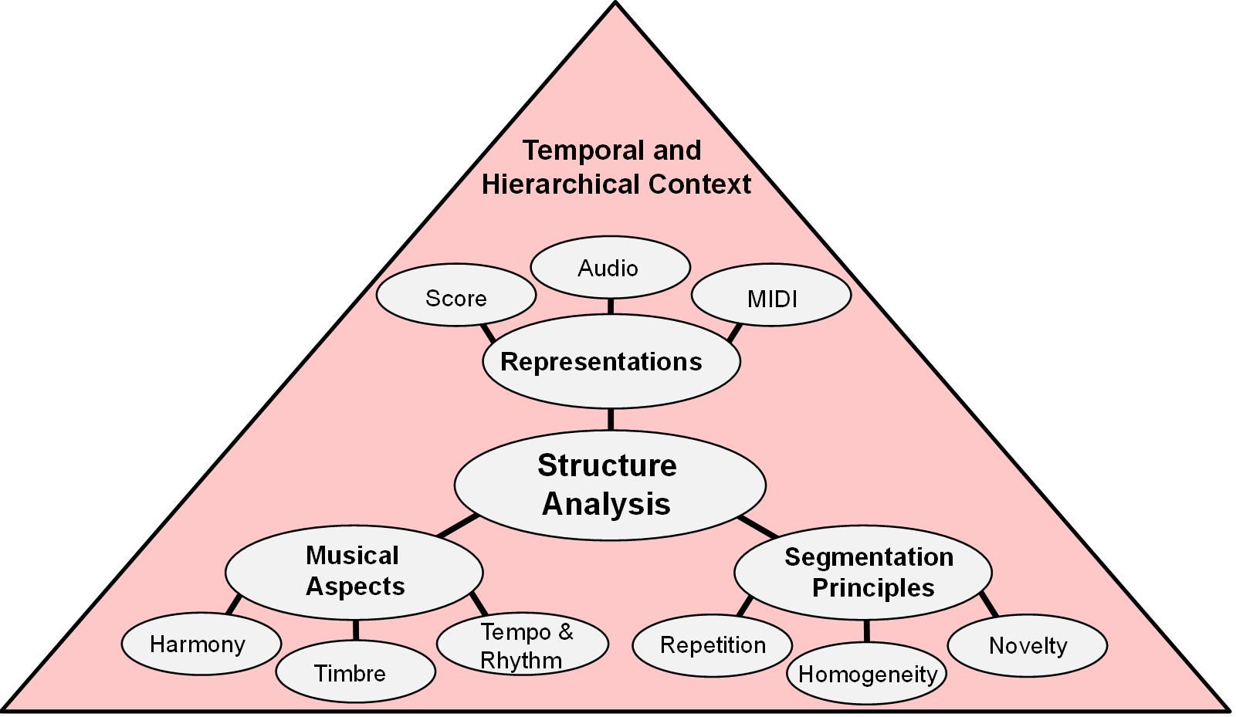
4.1 General Principles
Fig. 4.2

Slide 7
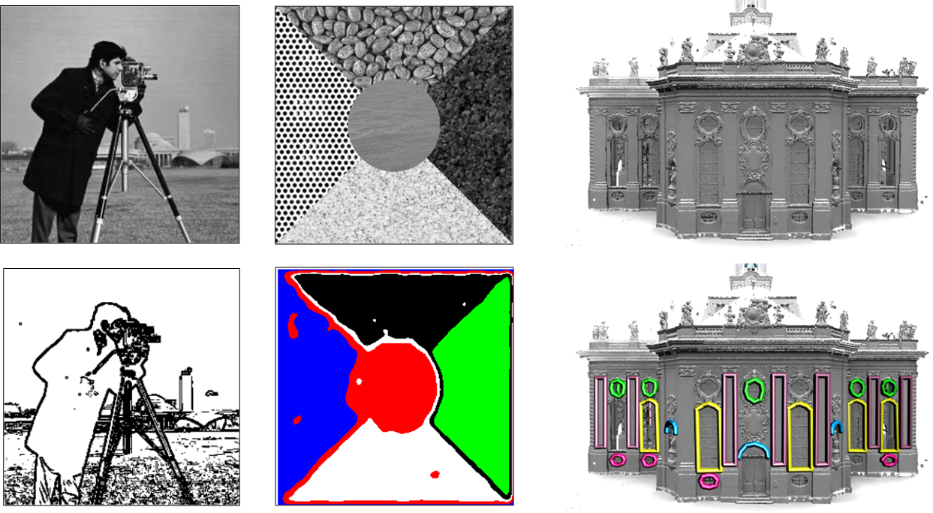
4.1 General Principles
Fig. 4.3

Slide 8
4.1 General Principles
Fig. 4.4

Slide 9
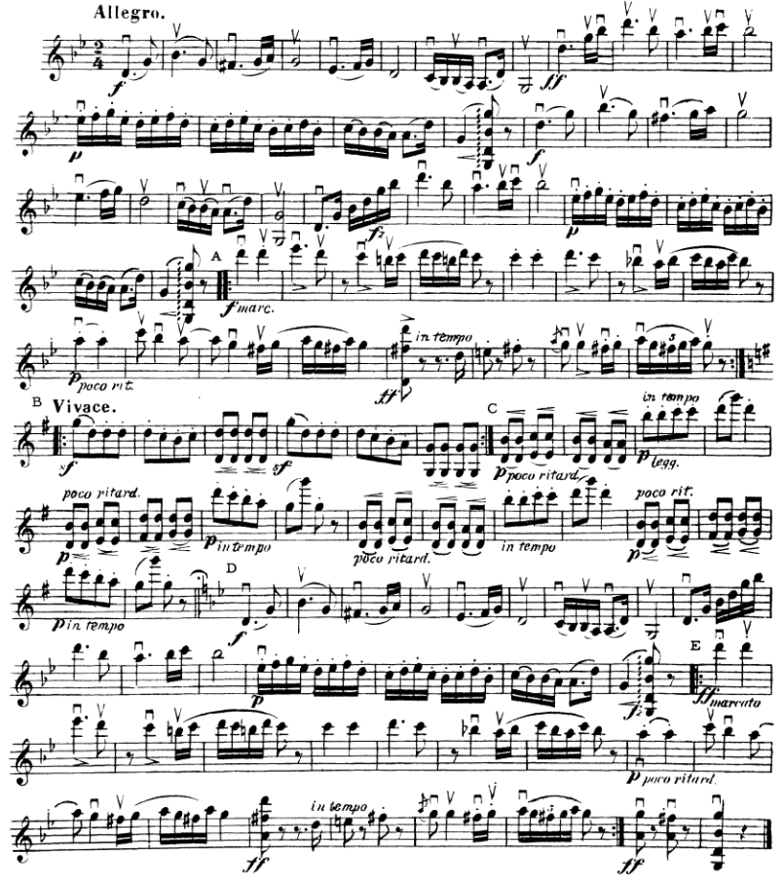
4.1 General Principles
Fig. 4.5

Slide 10
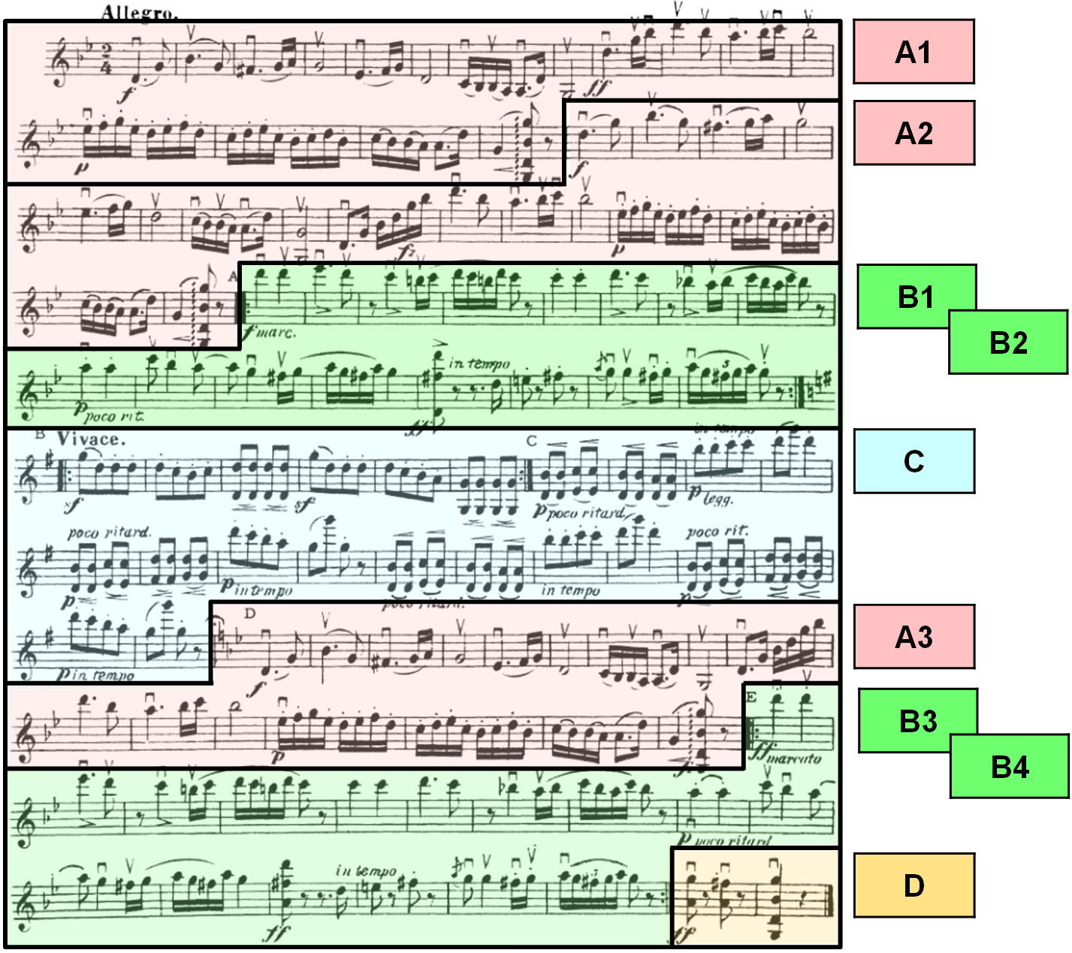
4.1 General Principles
Fig. 4.5

Slide 11
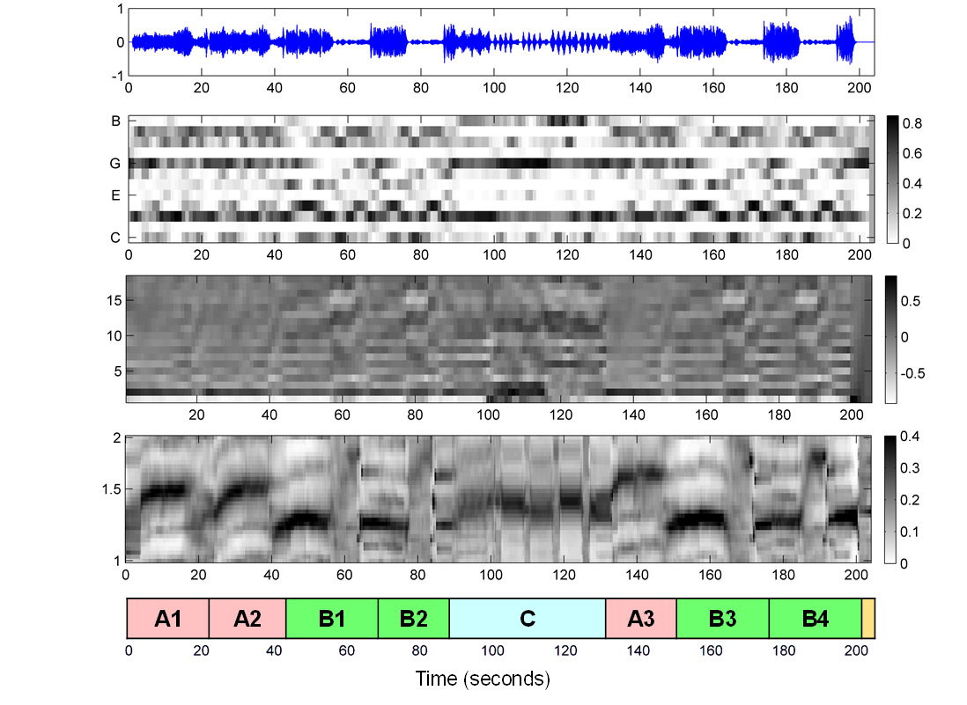
4.1 General Principles
Fig. 4.6

Slide 12
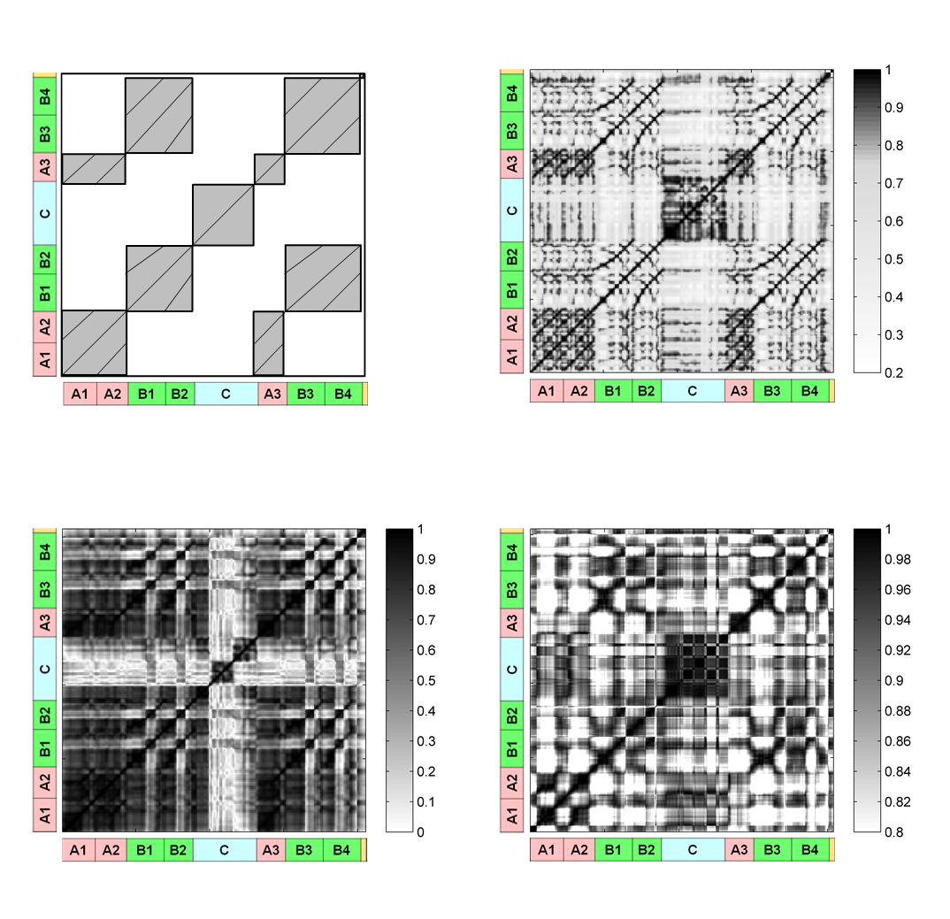
4.2 Self-Similarity Matrices
Fig. 4.7

Slide 13
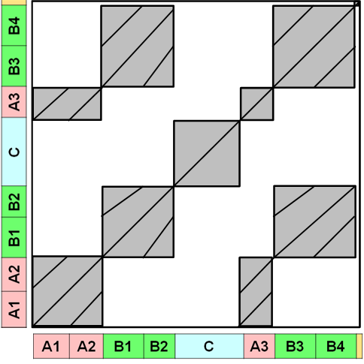
4.2 Self-Similarity Matrices
Fig. 4.7

Slide 14
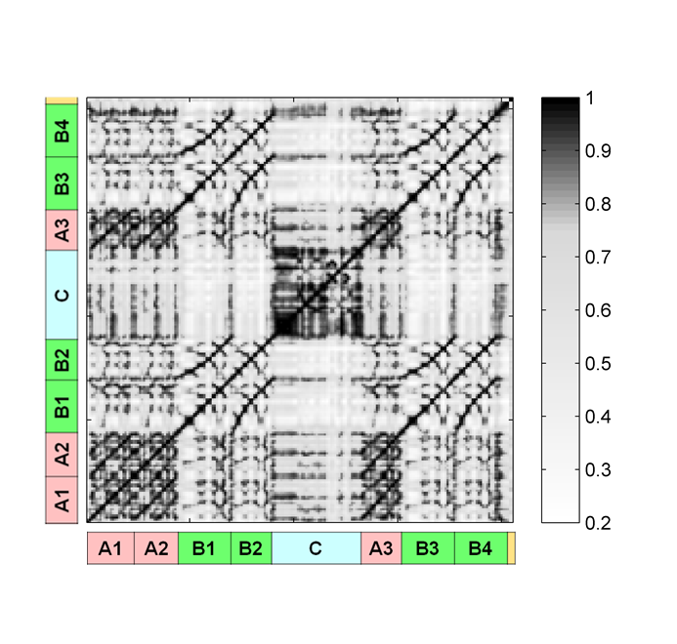
4.2 Self-Similarity Matrices
Fig. 4.7

Slide 15
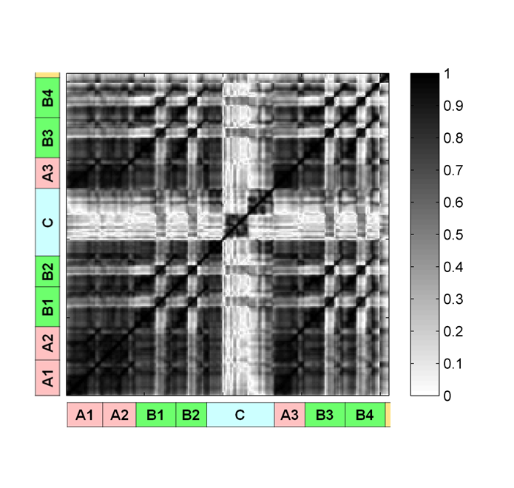
4.2 Self-Similarity Matrices
Fig. 4.7

Slide 16
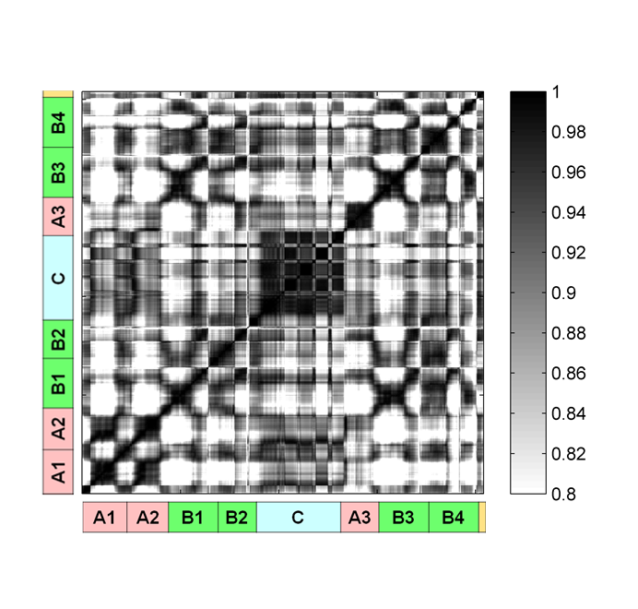
4.2 Self-Similarity Matrices
Fig. 4.7

Slide 17
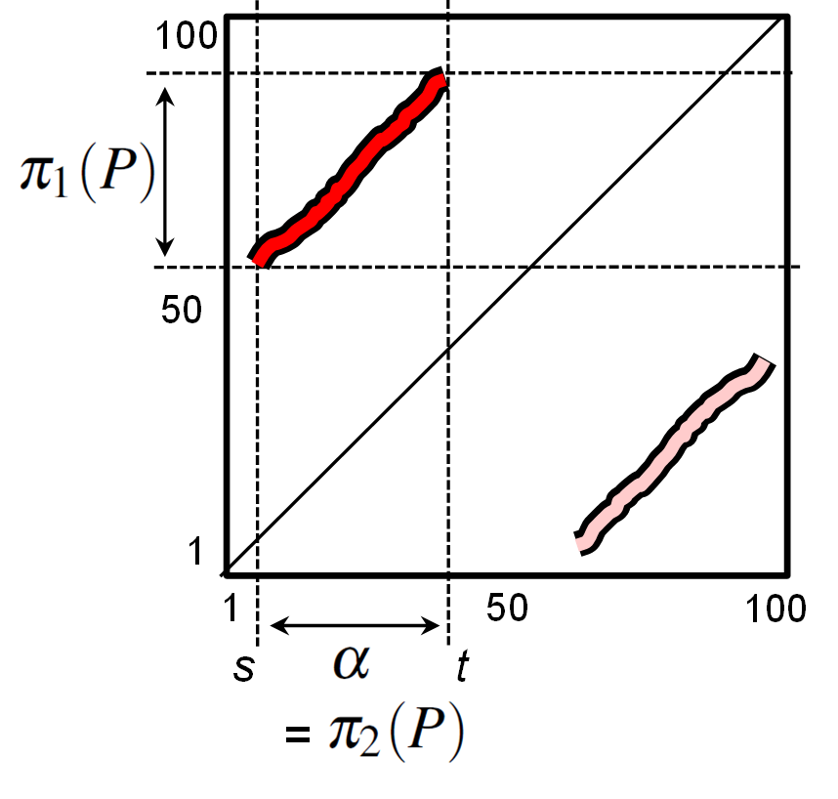
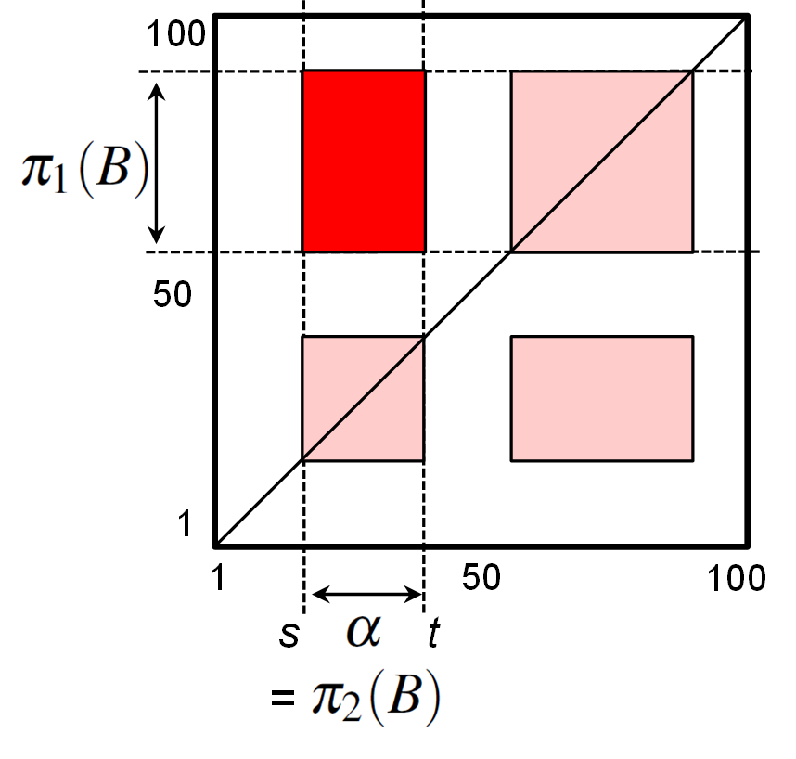
4.2 Self-Similarity Matrices
Fig. 4.8

Slide 18
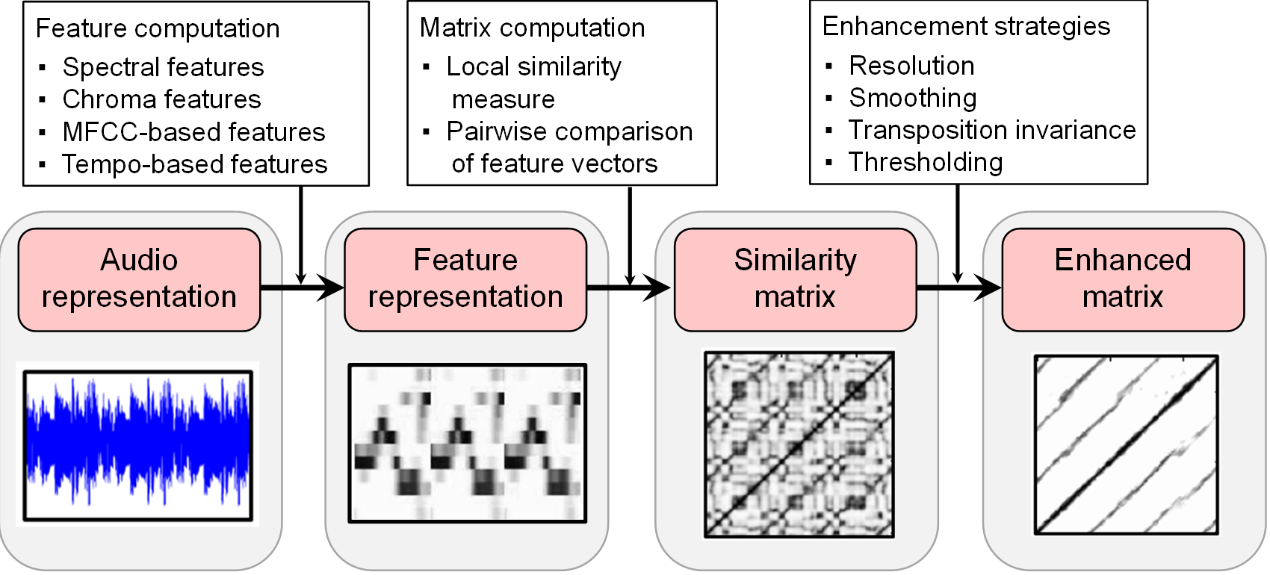
4.2 Self-Similarity Matrices
Fig. 4.9

Slide 19
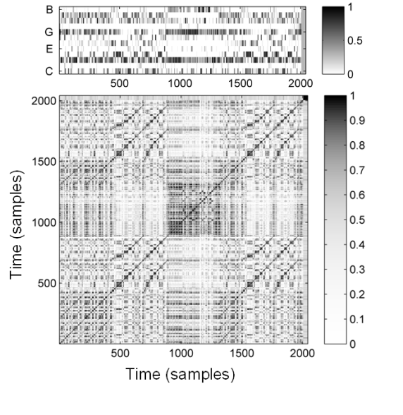
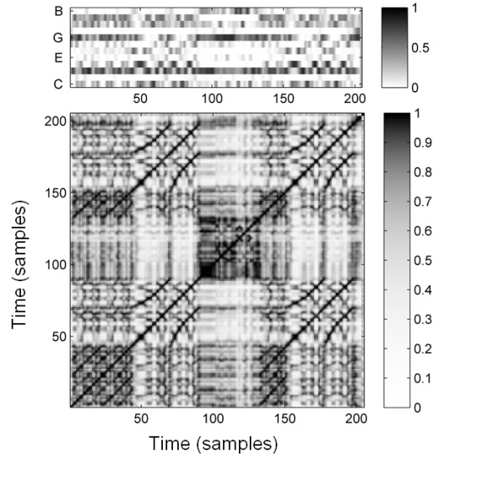
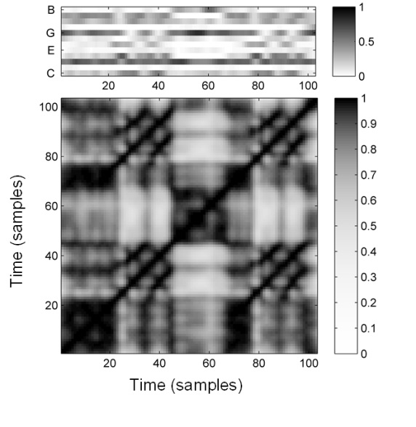
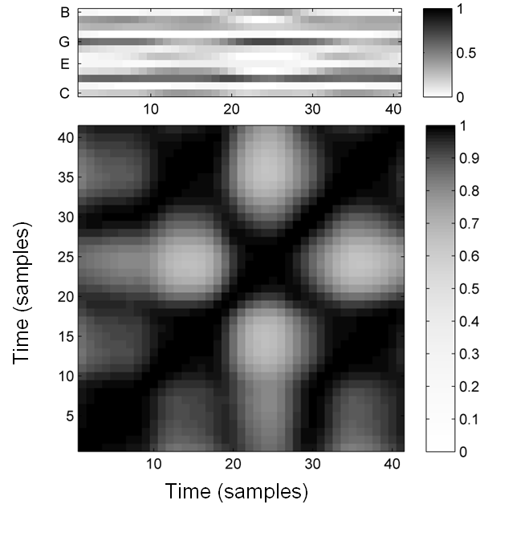
4.2 Self-Similarity Matrices
Fig. 4.10

Slide 20
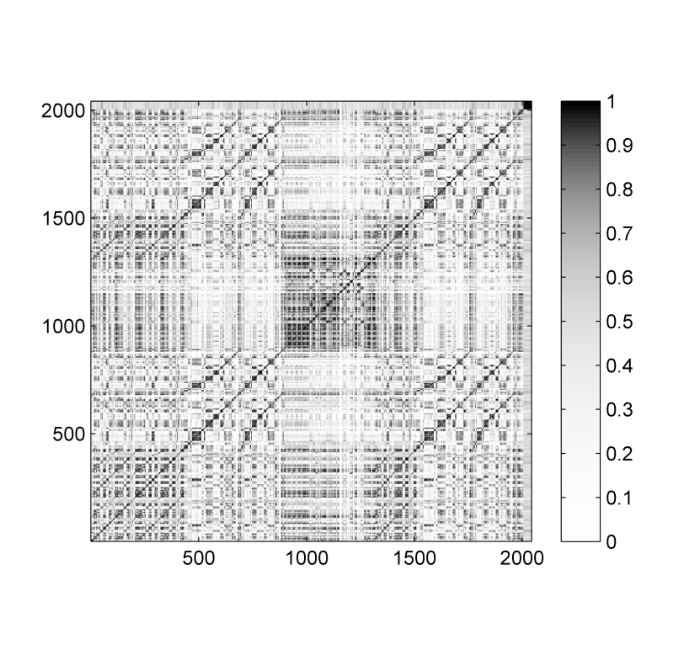
4.2 Self-Similarity Matrices
Fig. 4.10
Time (samples)
Time (samples)

Slide 21
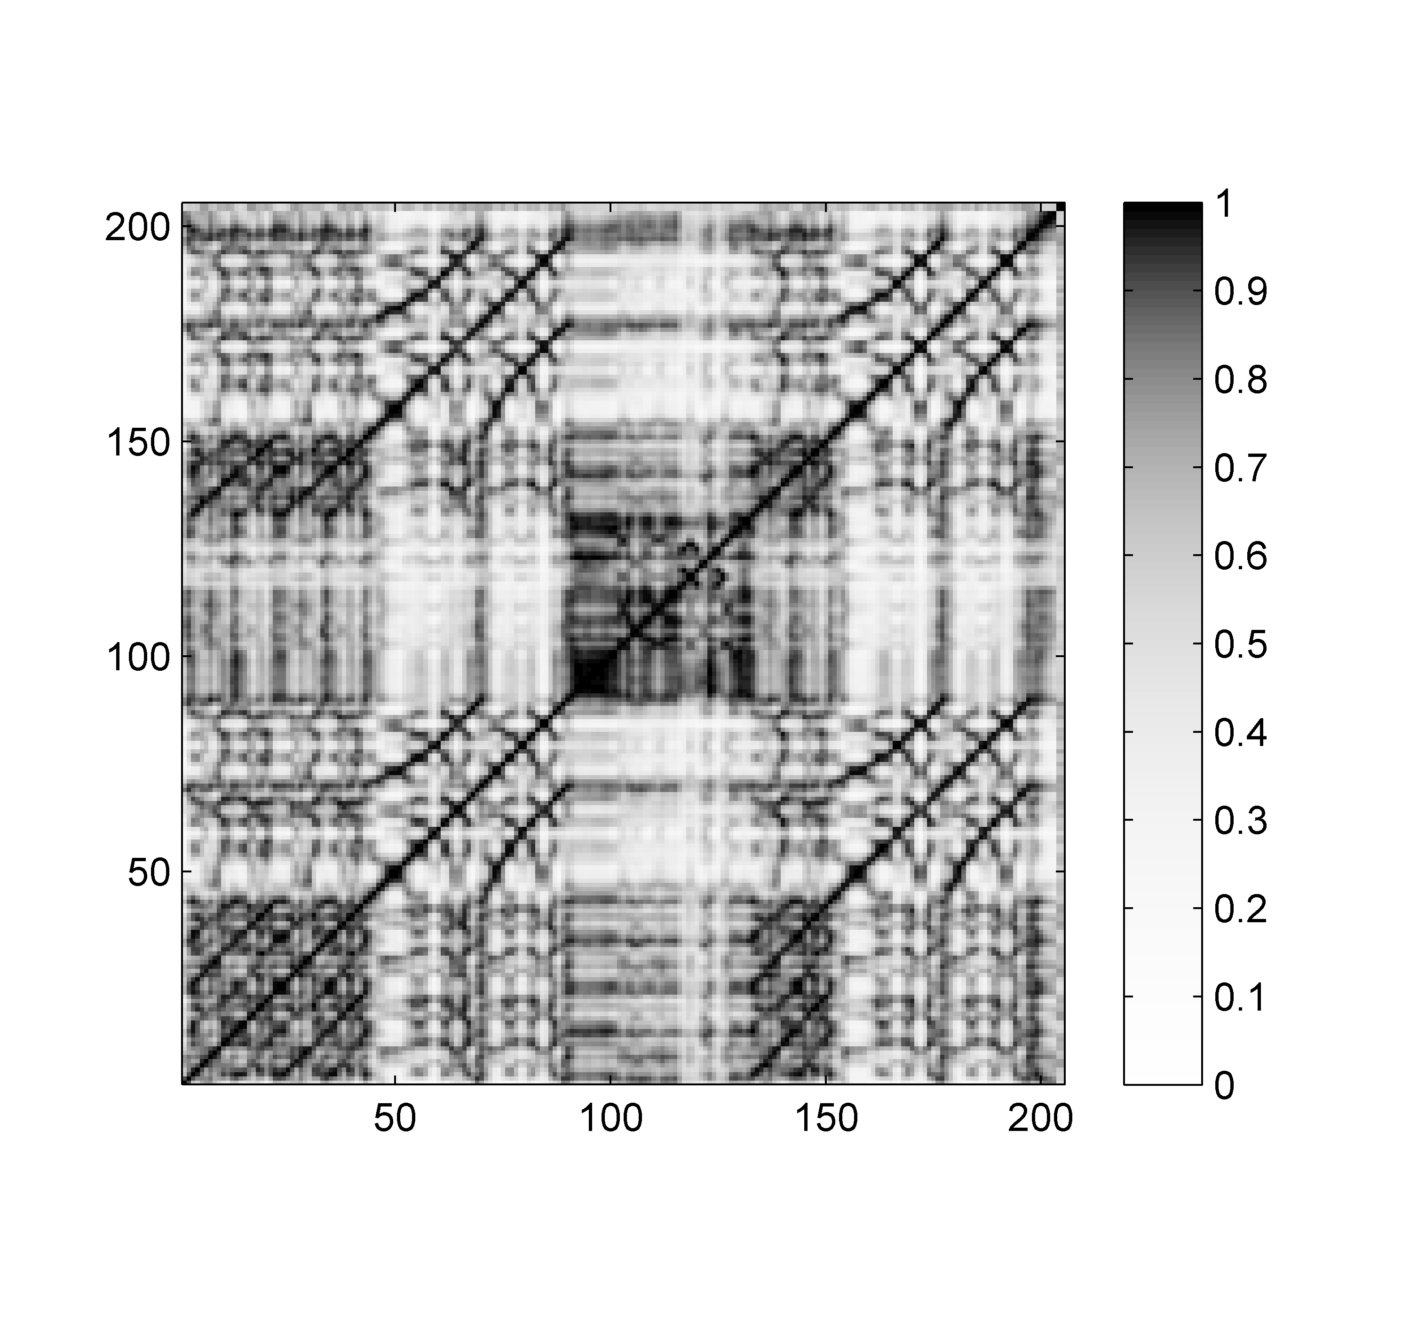
4.2 Self-Similarity Matrices
Fig. 4.10
Time (samples)
Time (samples)

Slide 22
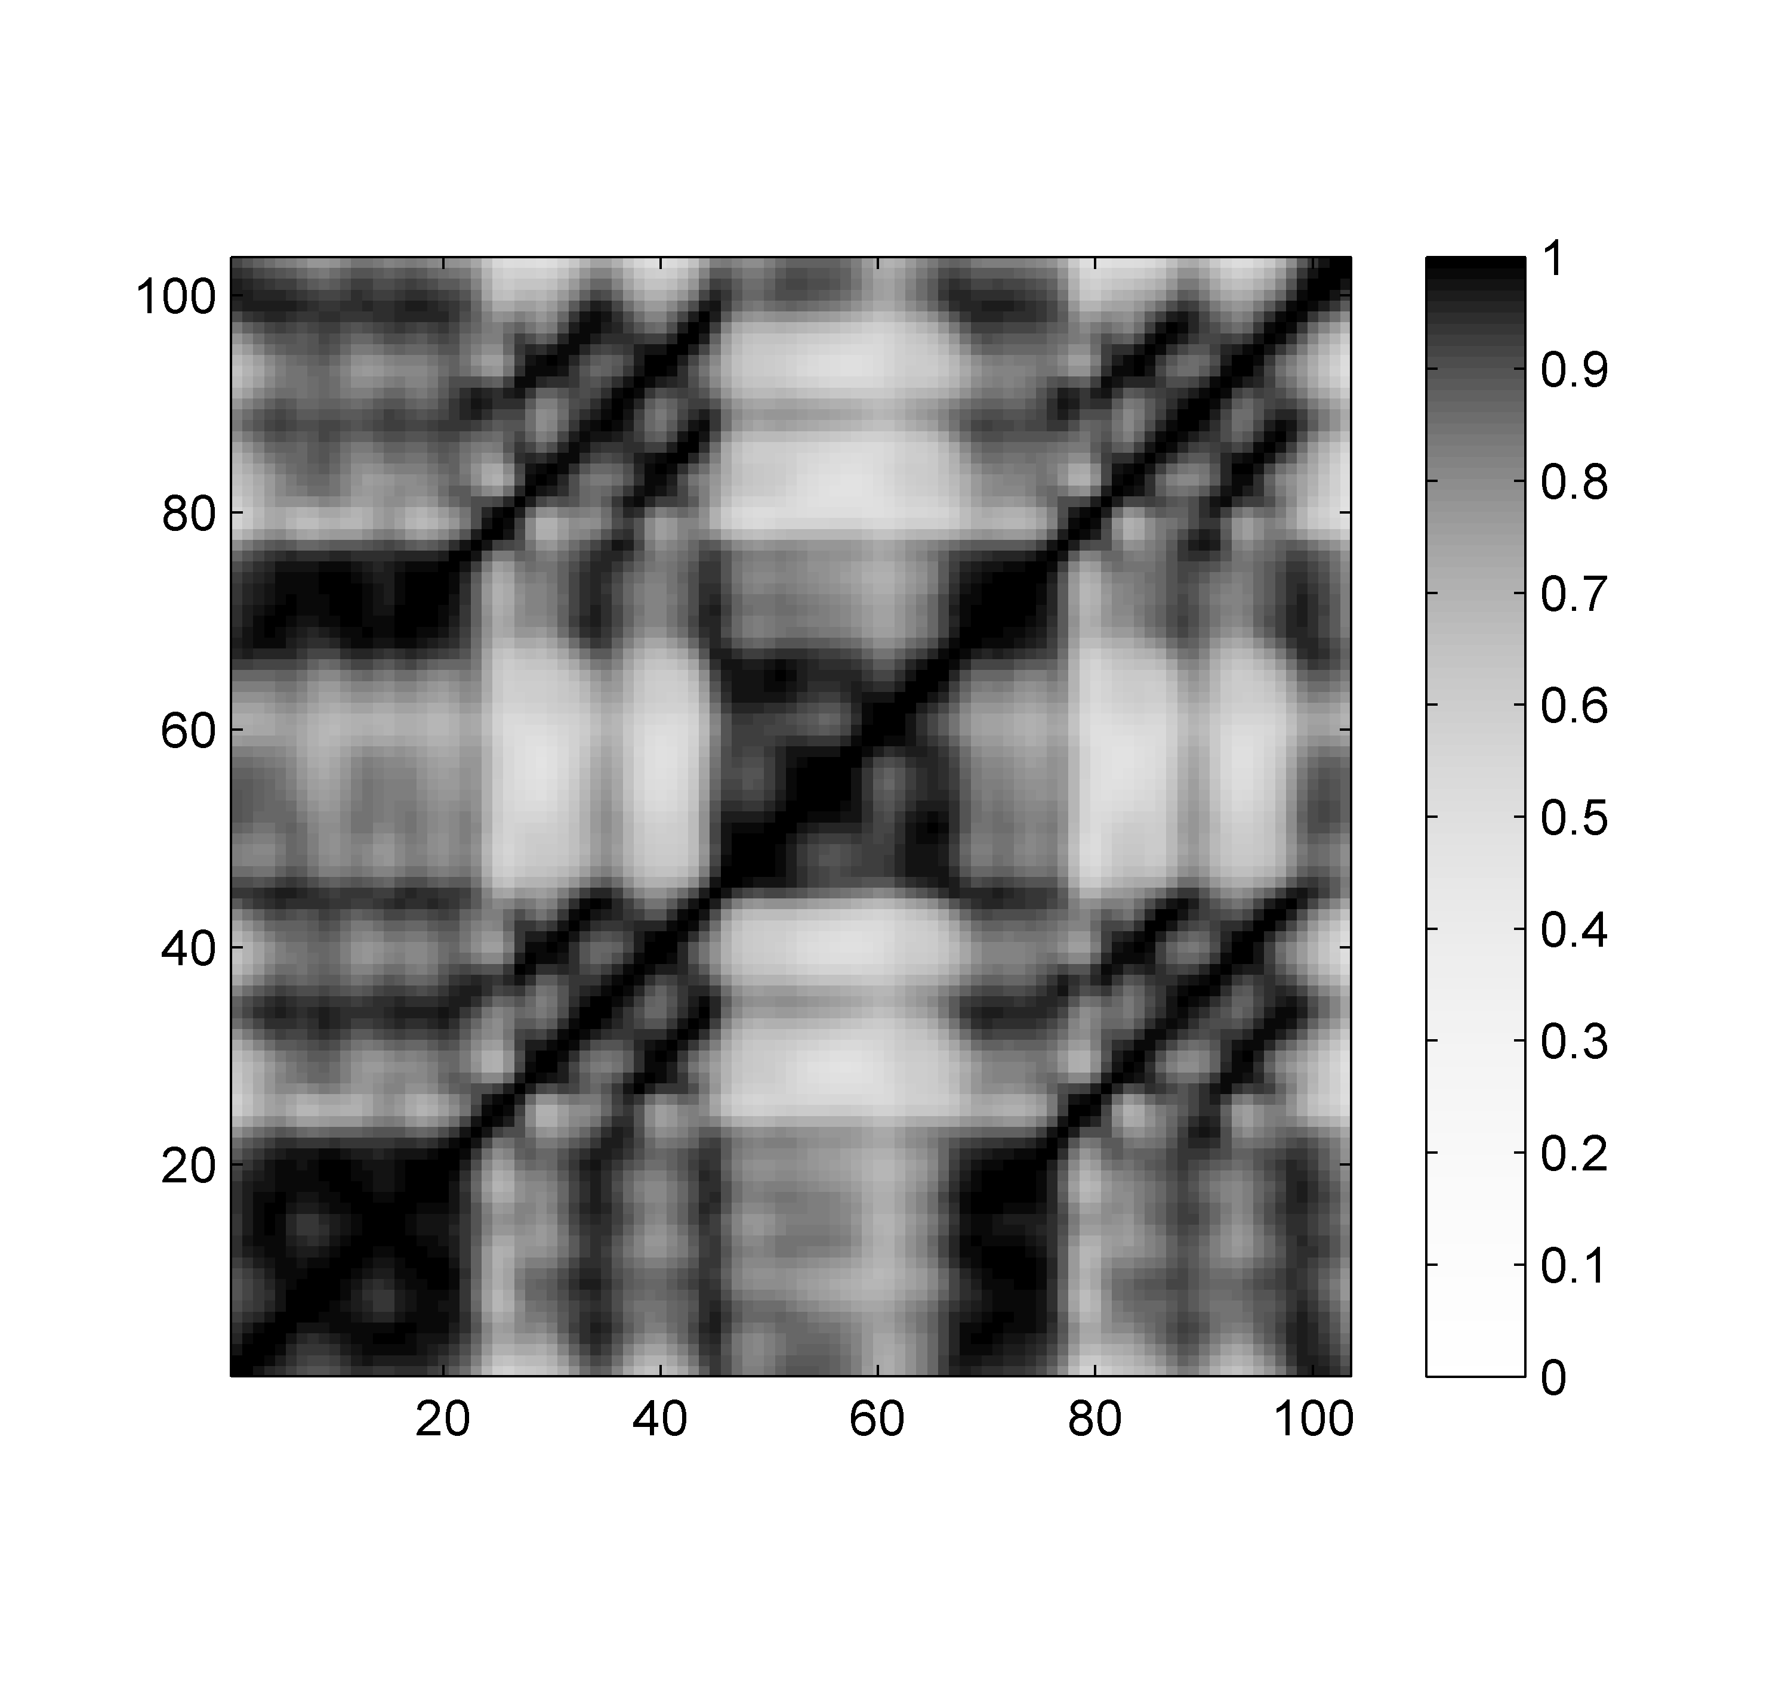
4.2 Self-Similarity Matrices
Fig. 4.10
Time (samples)
Time (samples)

Slide 23
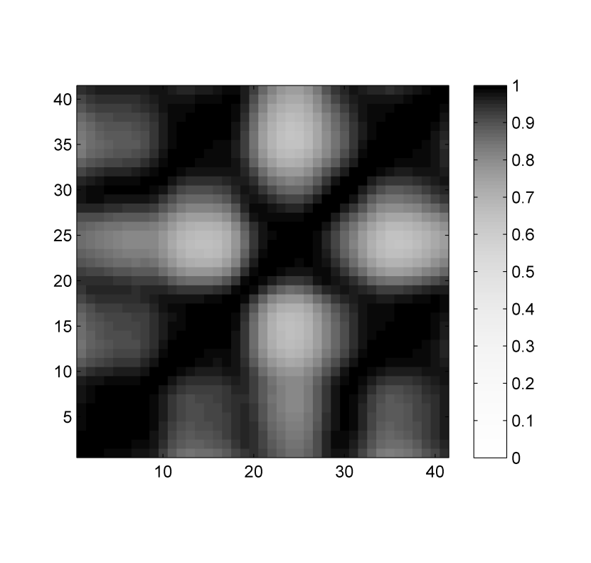
4.2 Self-Similarity Matrices
Fig. 4.10
Time (samples)
Time (samples)

Slide 24
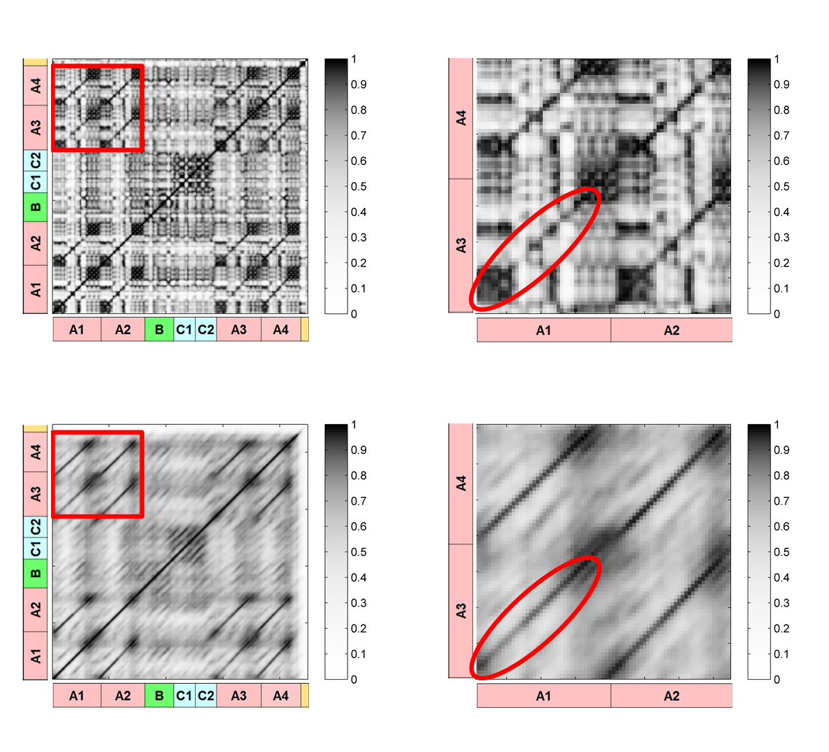
4.2 Self-Similarity Matrices
Fig. 4.11

Slide 25
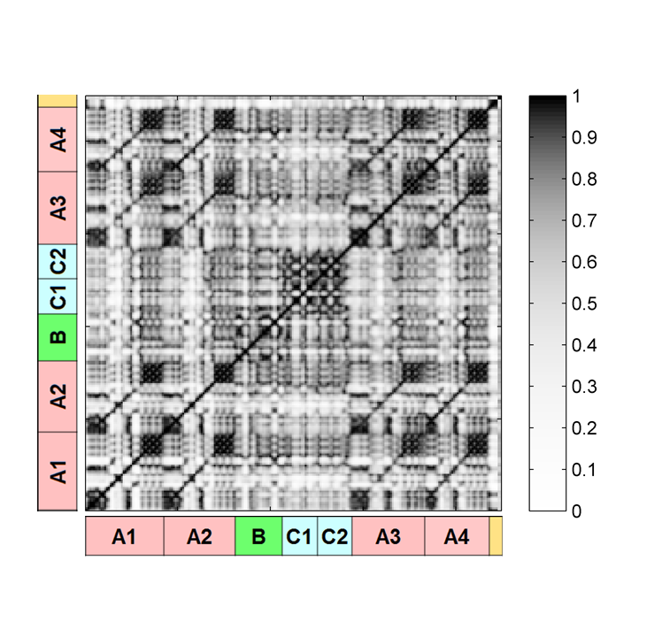
4.2 Self-Similarity Matrices
Fig. 4.11

Slide 26
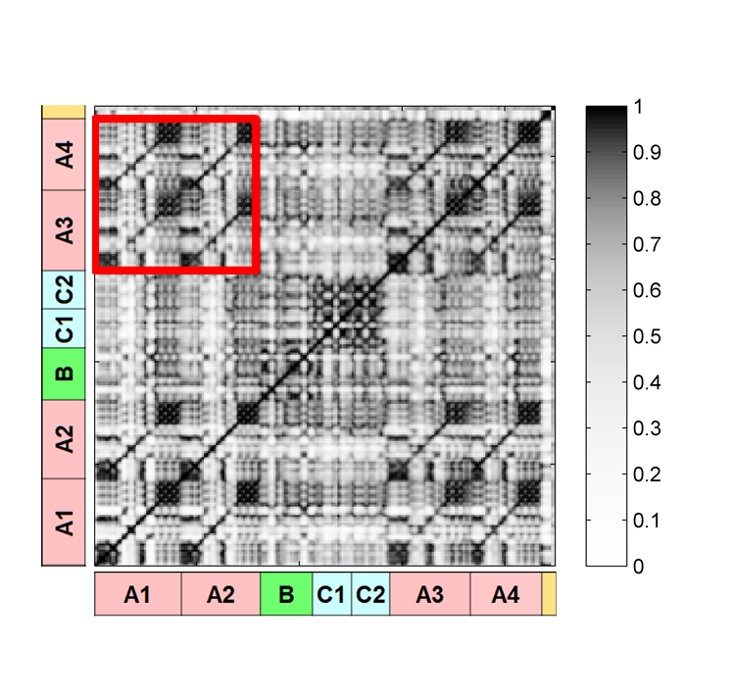
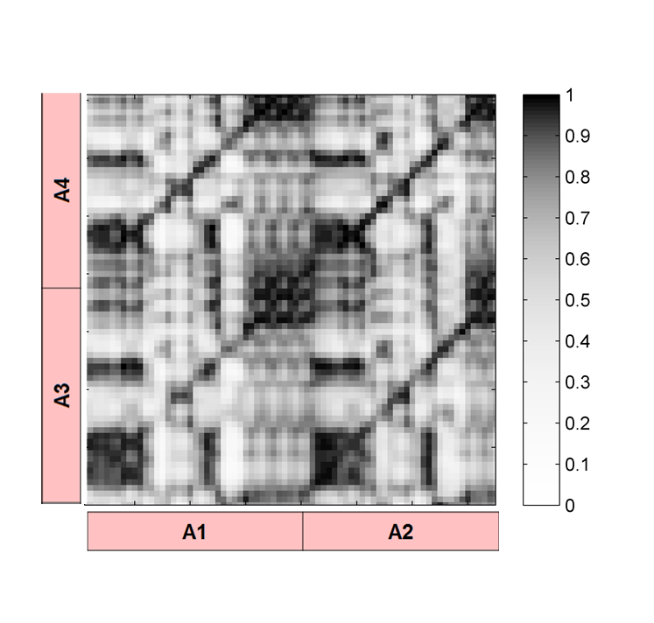
4.2 Self-Similarity Matrices
Fig. 4.11

Slide 27
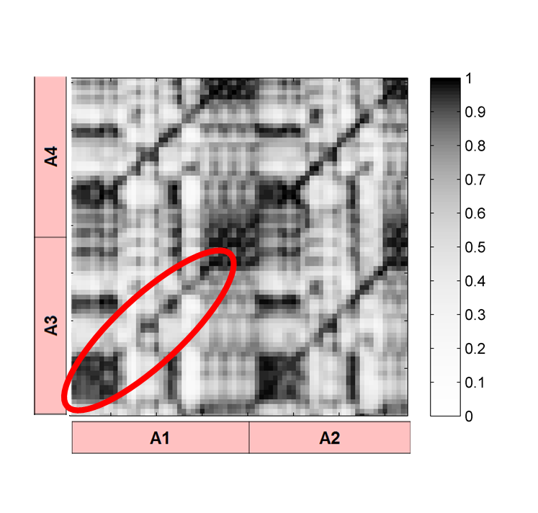
4.2 Self-Similarity Matrices
Fig. 4.11

Slide 28
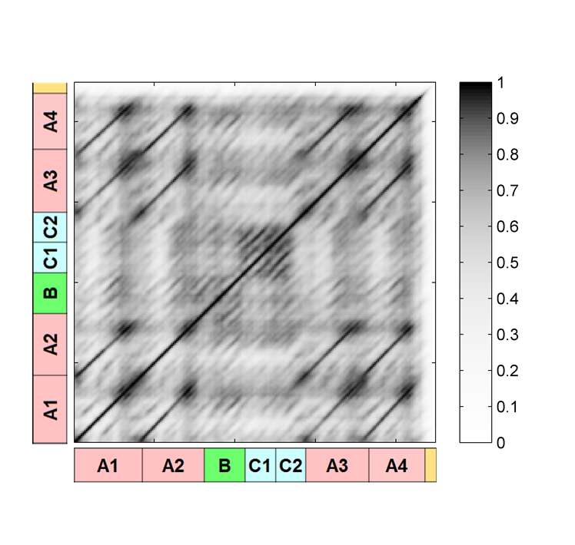
4.2 Self-Similarity Matrices
Fig. 4.11

Slide 29
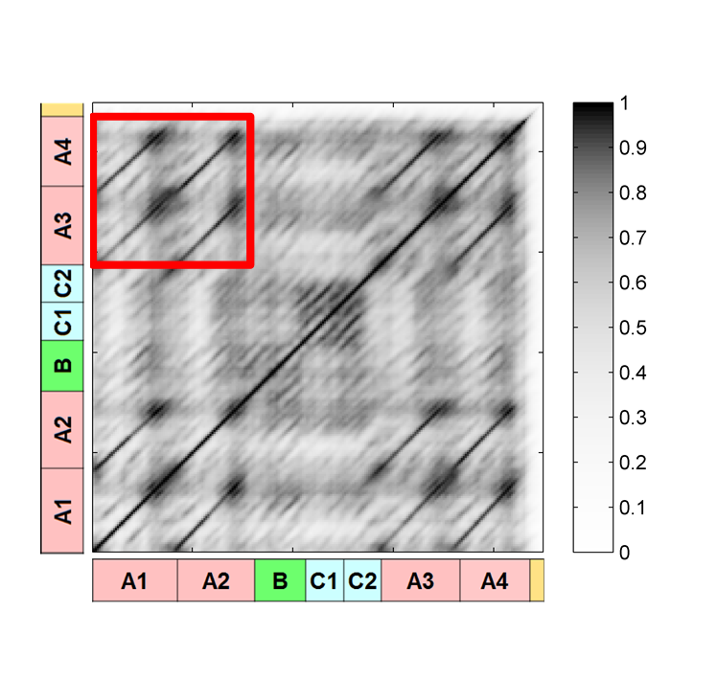
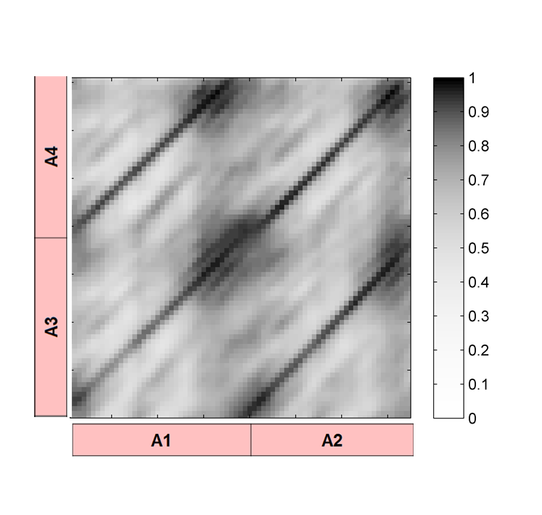
4.2 Self-Similarity Matrices
Fig. 4.11

Slide 30
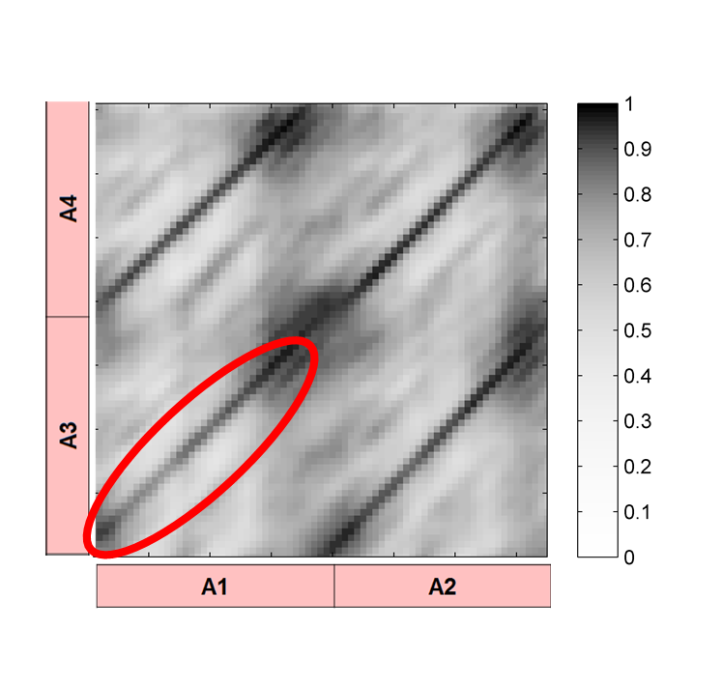
4.2 Self-Similarity Matrices
Fig. 4.11

Slide 31
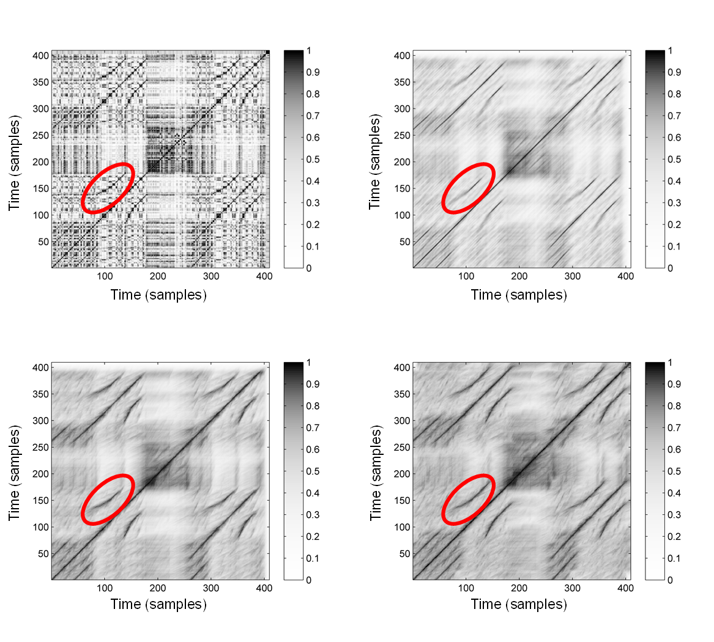
4.2 Self-Similarity Matrices
Fig. 4.12

Slide 32
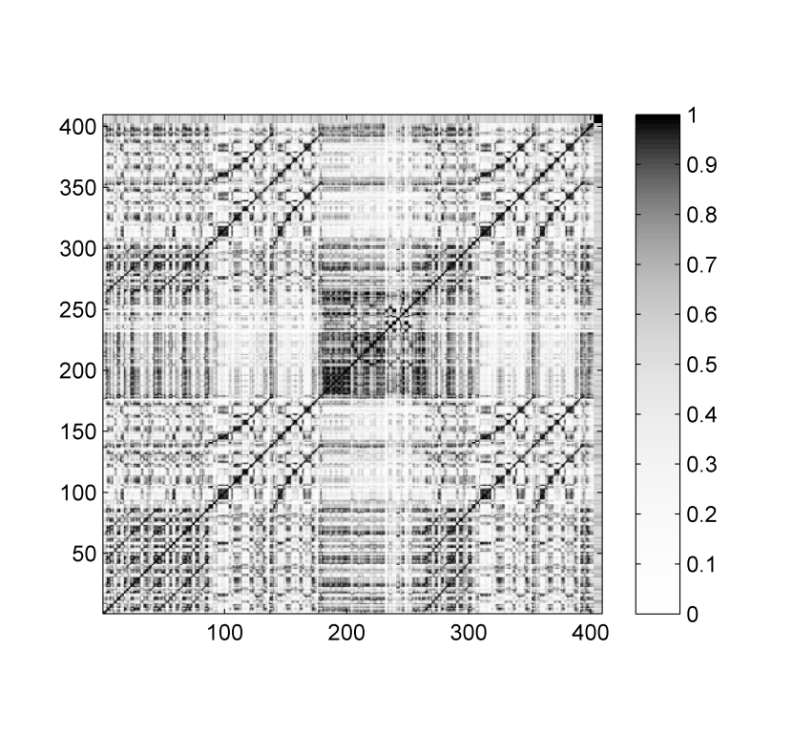
4.2 Self-Similarity Matrices
Fig. 4.12
Time (samples)
Time (samples)

Slide 33
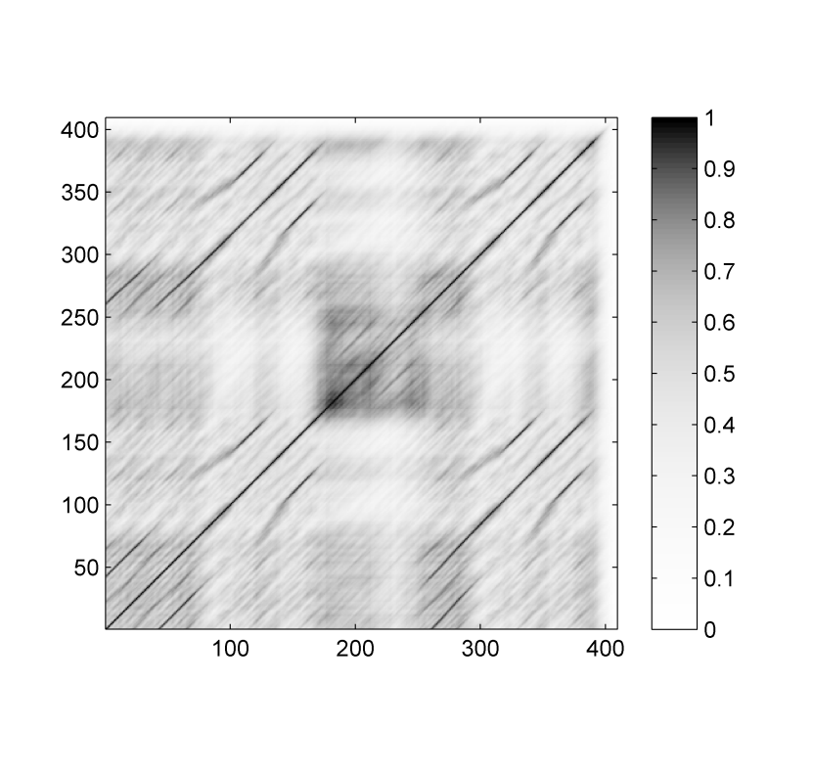
4.2 Self-Similarity Matrices
Fig. 4.12
Time (samples)
Time (samples)

Slide 34
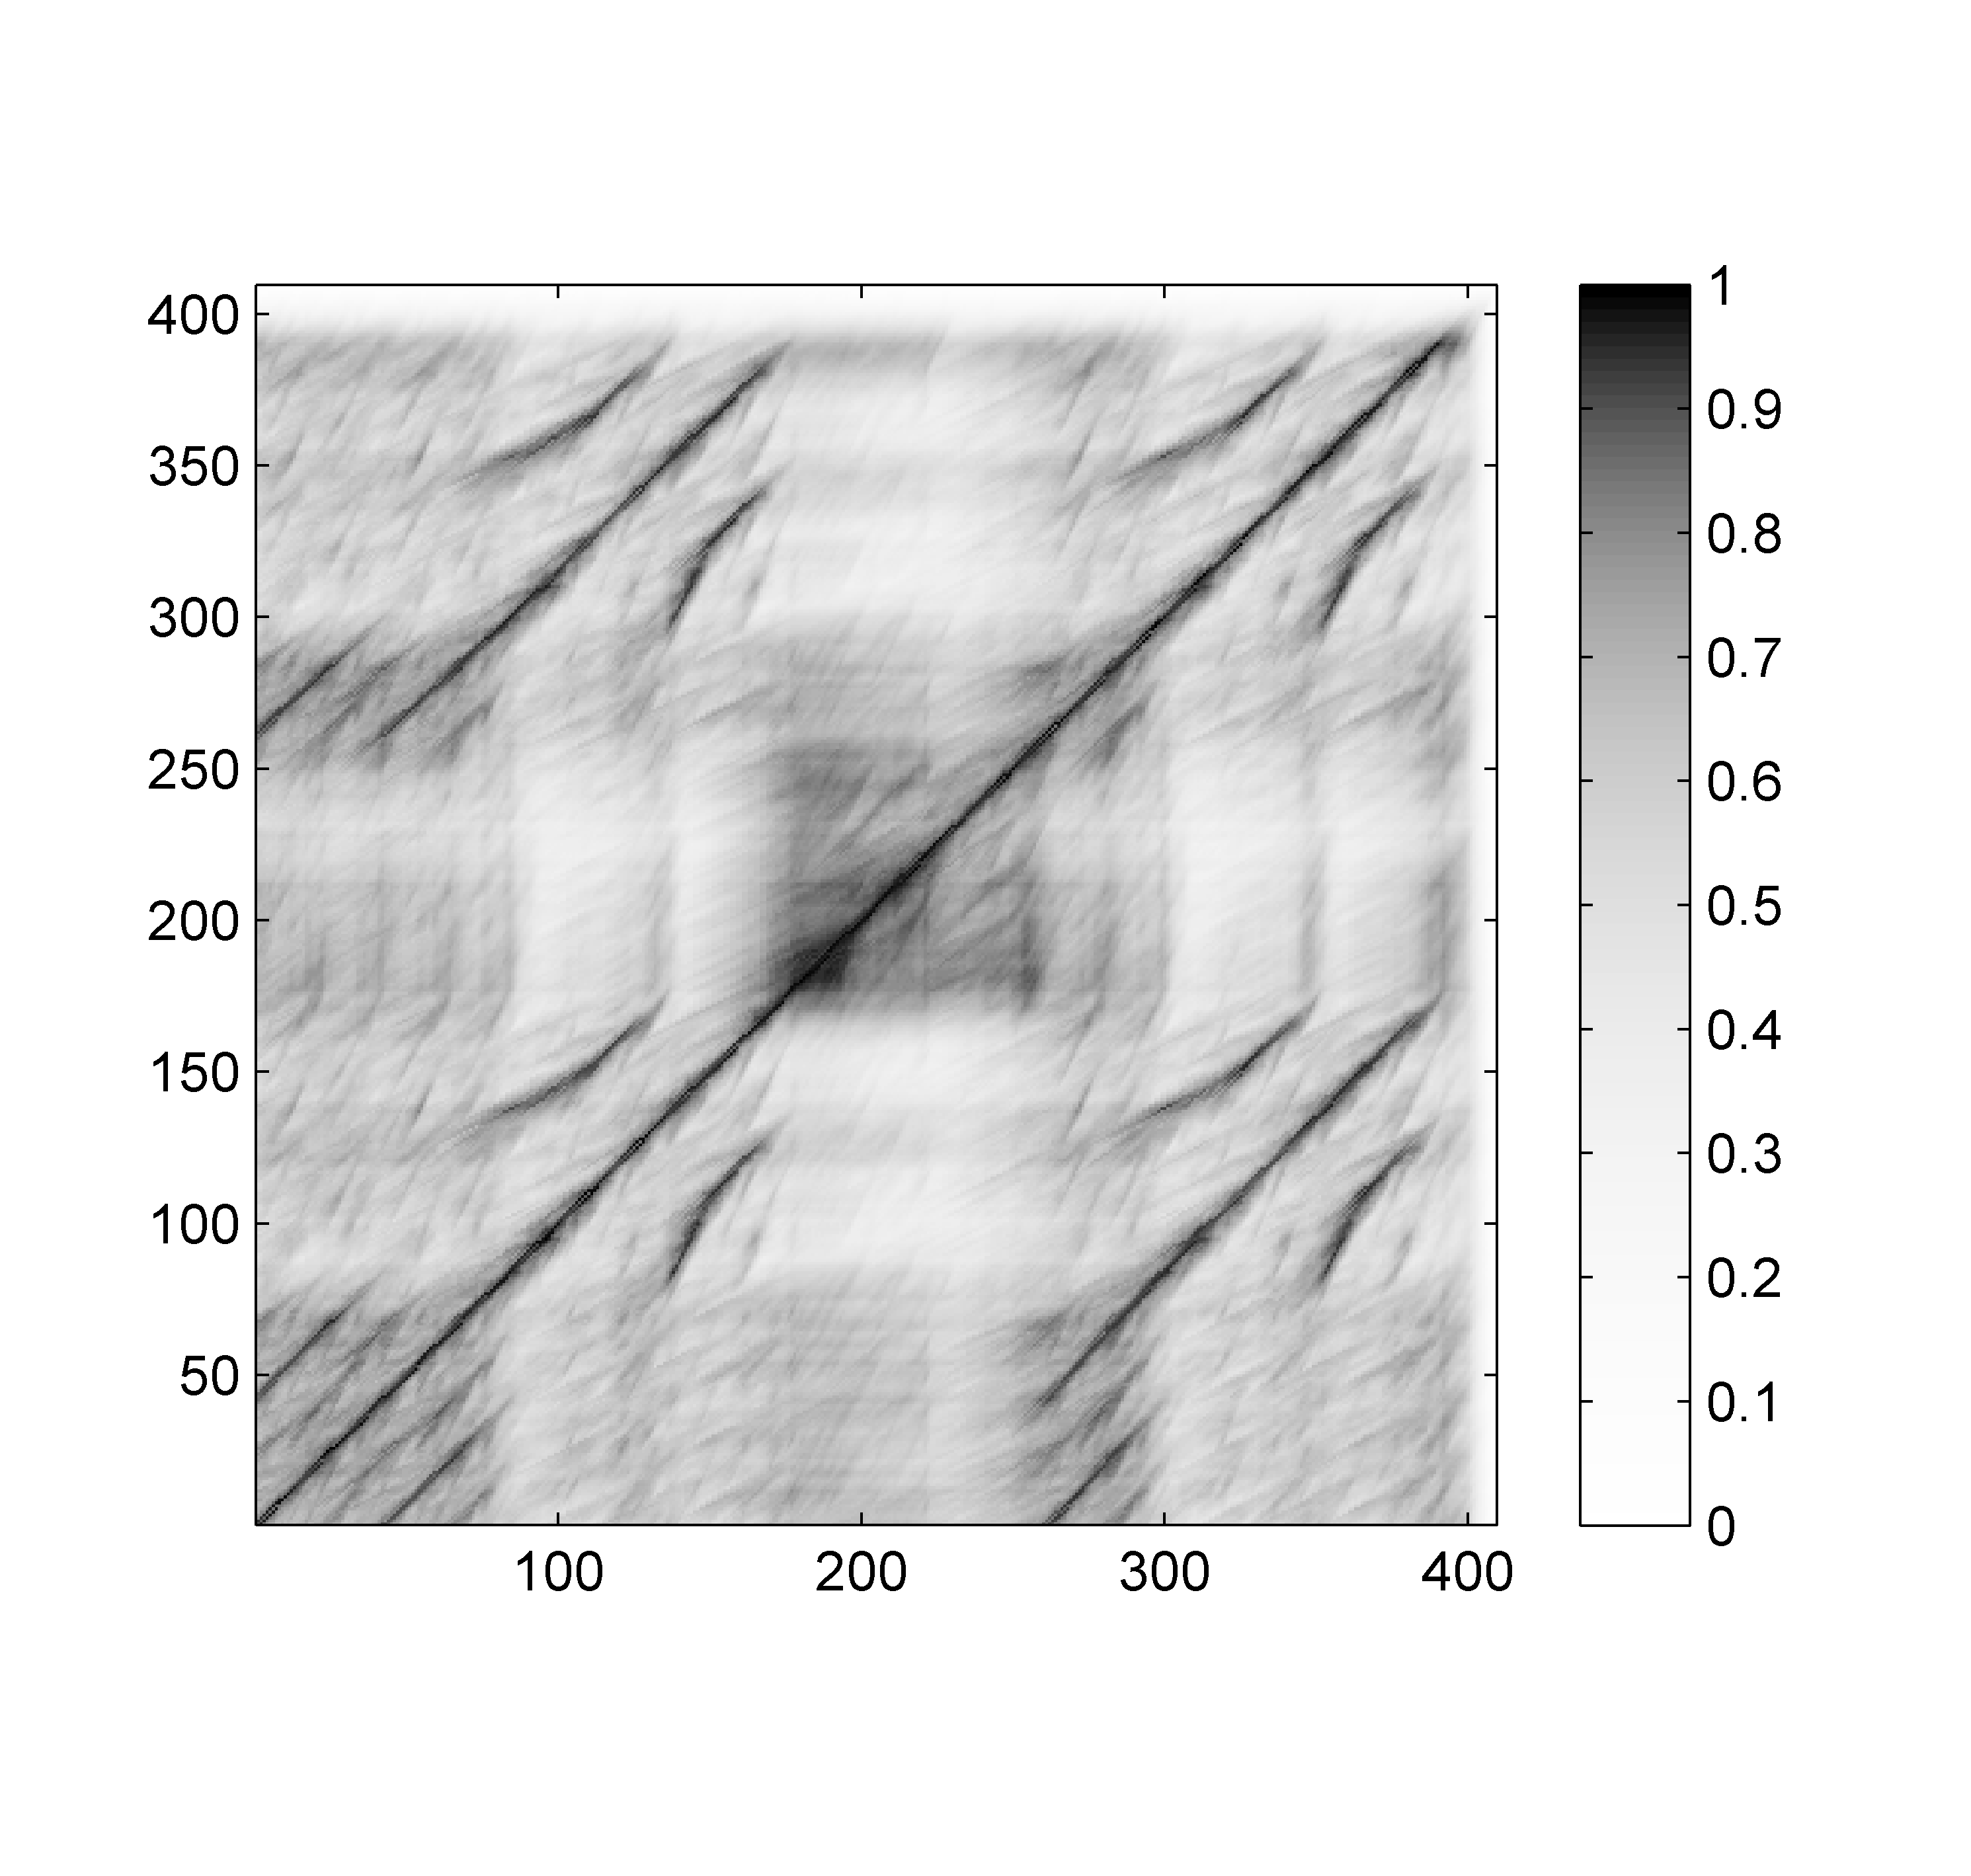
4.2 Self-Similarity Matrices
Fig. 4.12
Time (samples)
Time (samples)

Slide 35
4.2 Self-Similarity Matrices
Fig. 4.12
Time (samples)
Time (samples)

Slide 36
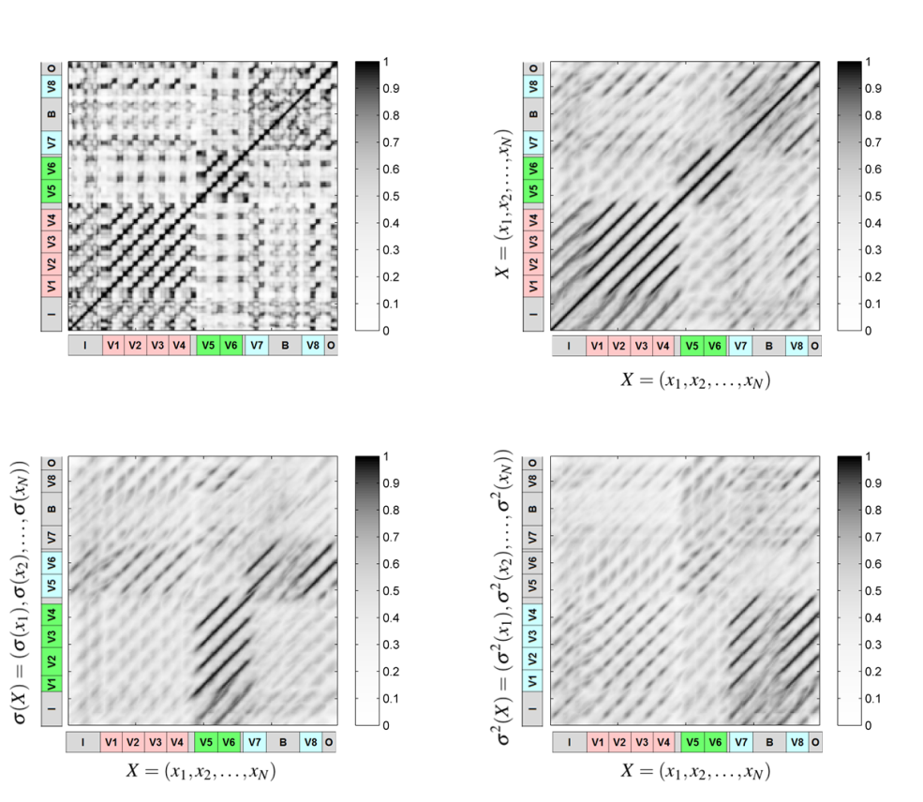
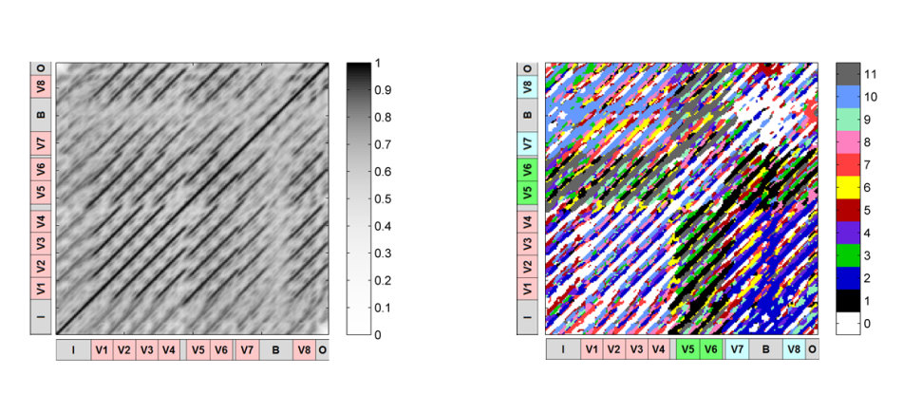
4.2 Self-Similarity Matrices
Fig. 4.13

Slide 37
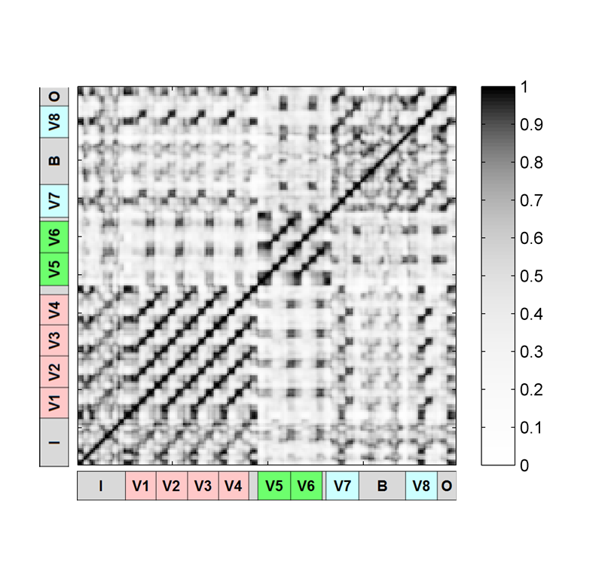
4.2 Self-Similarity Matrices
Fig. 4.13

Slide 38
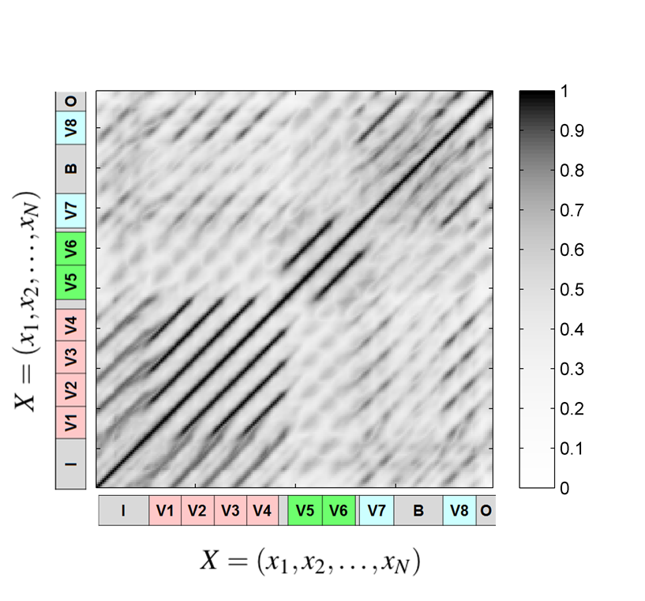
4.2 Self-Similarity Matrices
Fig. 4.13

Slide 39
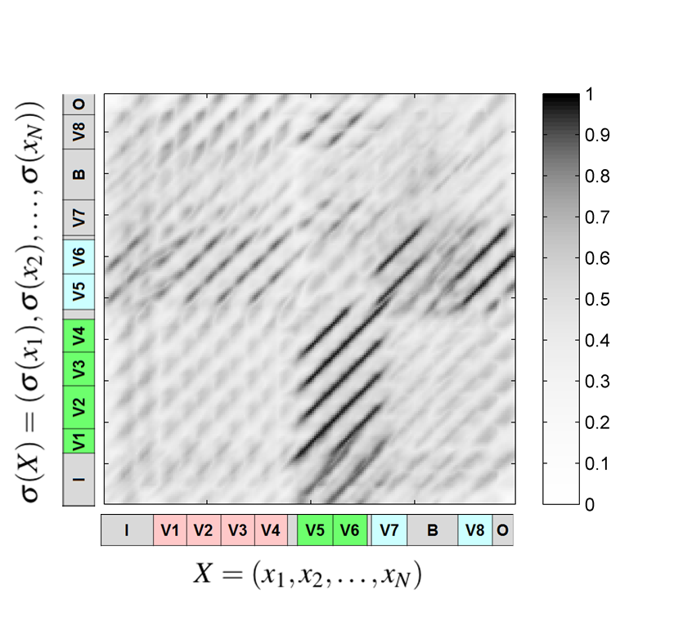
4.2 Self-Similarity Matrices
Fig. 4.13

Slide 40
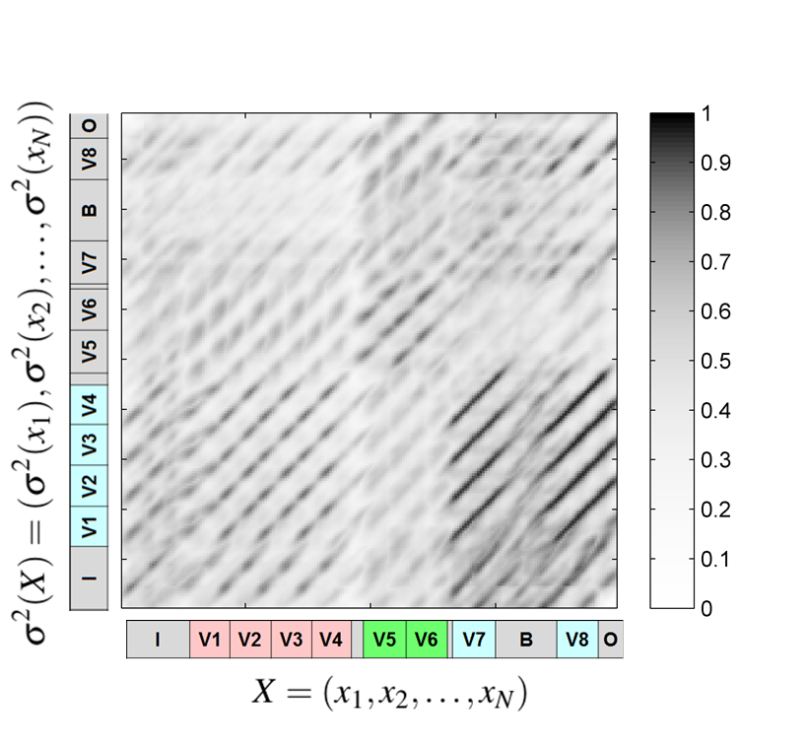
4.2 Self-Similarity Matrices
Fig. 4.13

Slide 41
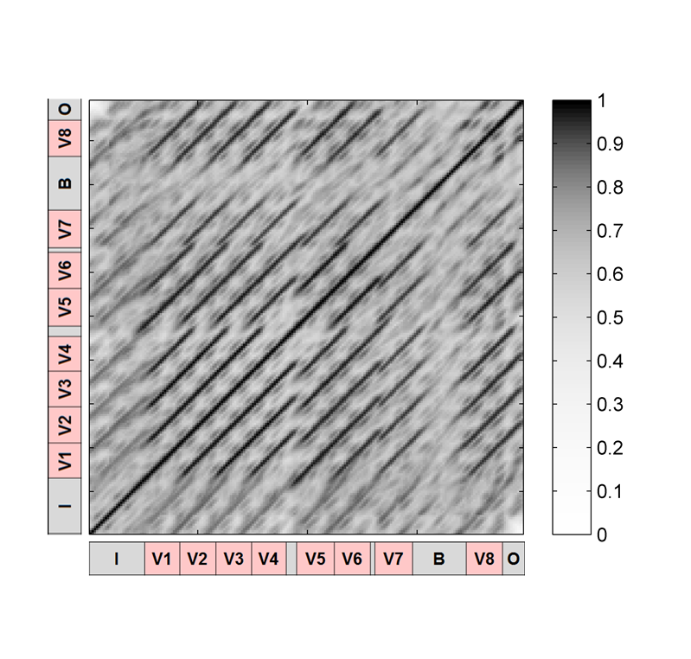
4.2 Self-Similarity Matrices
Fig. 4.13

Slide 42
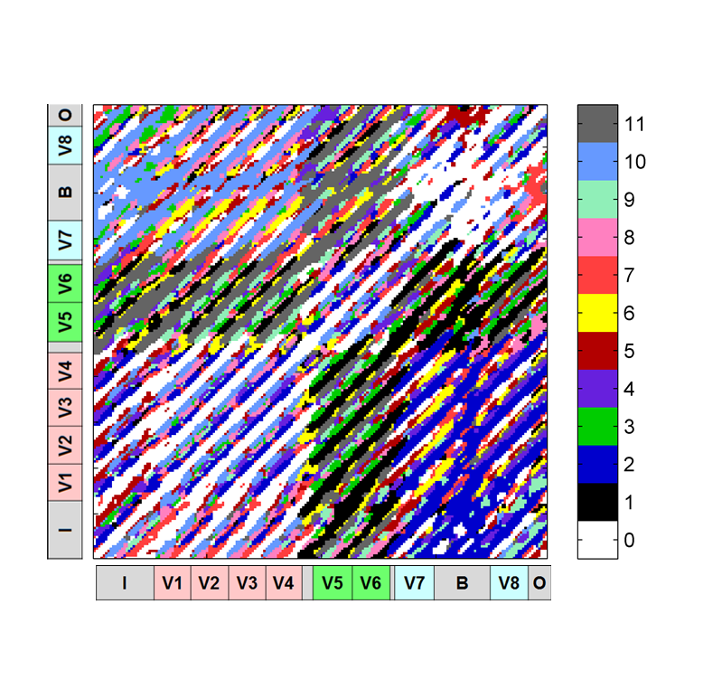
4.2 Self-Similarity Matrices
Fig. 4.13

Slide 43
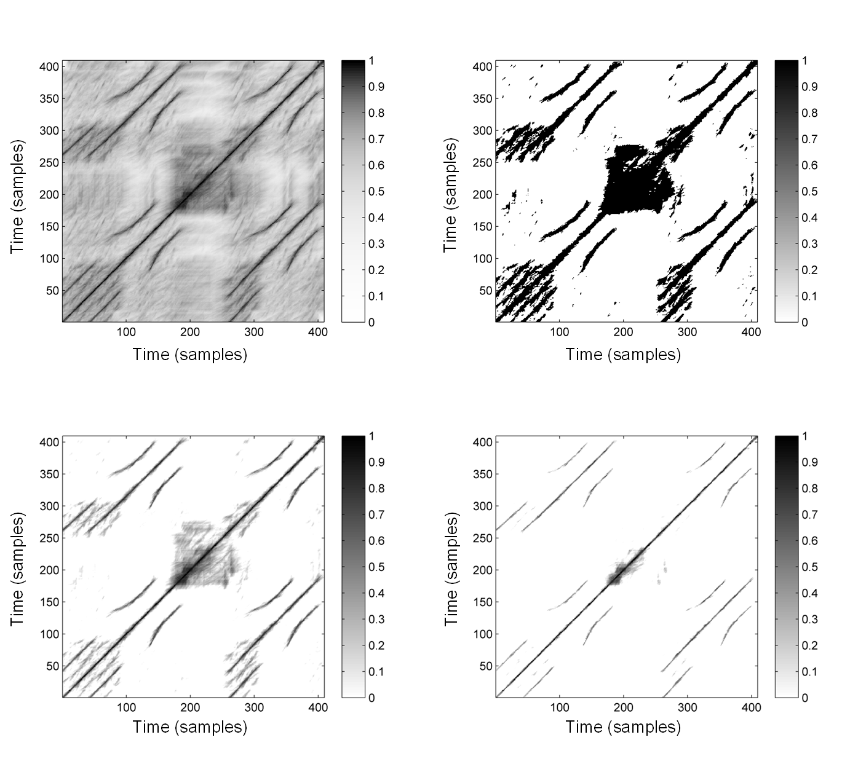
4.2 Self-Similarity Matrices
Fig. 4.14

Slide 44
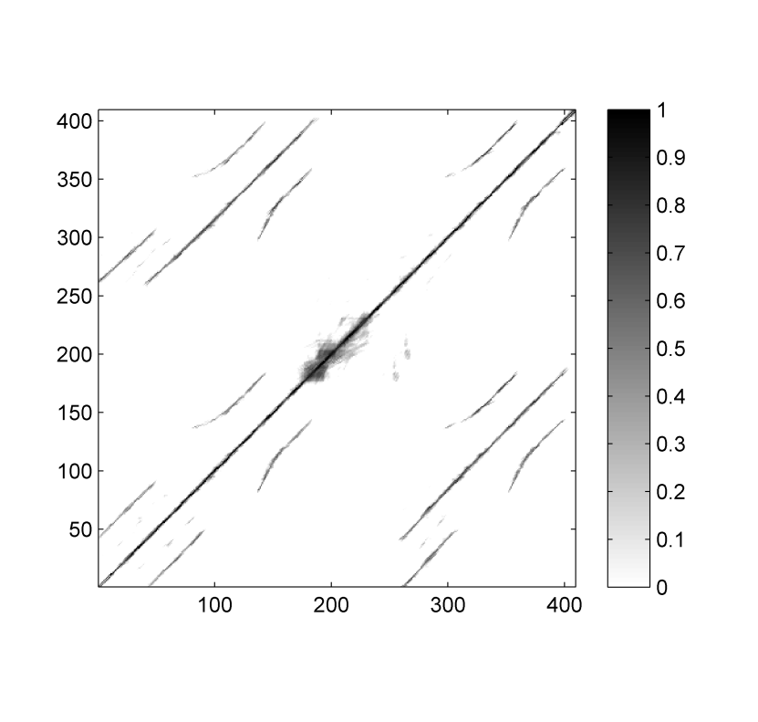
4.2 Self-Similarity Matrices
Fig. 4.14
Time (samples)
Time (samples)

Slide 45
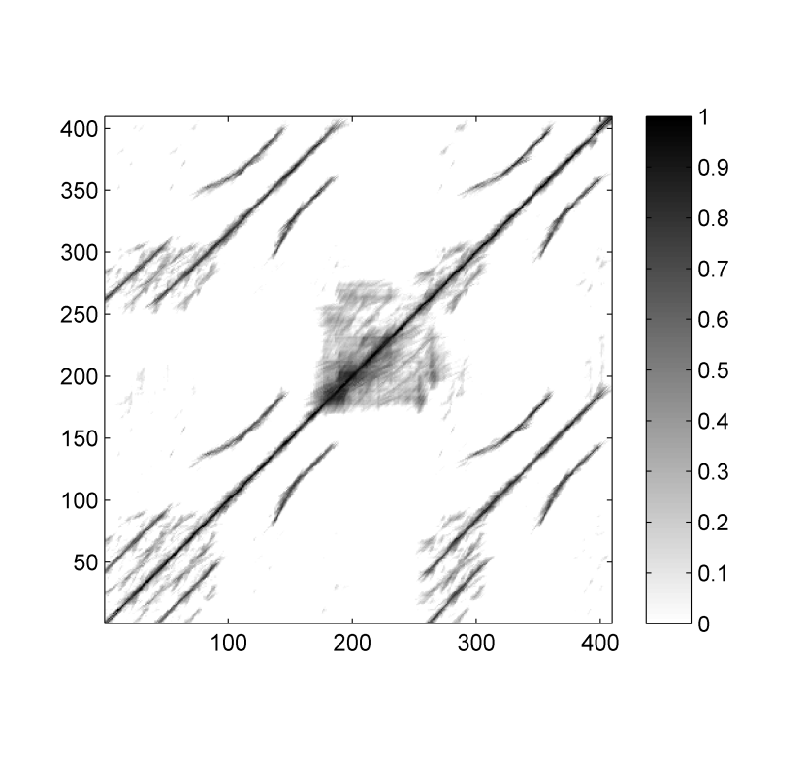
4.2 Self-Similarity Matrices
Fig. 4.14
Time (samples)
Time (samples)

Slide 46
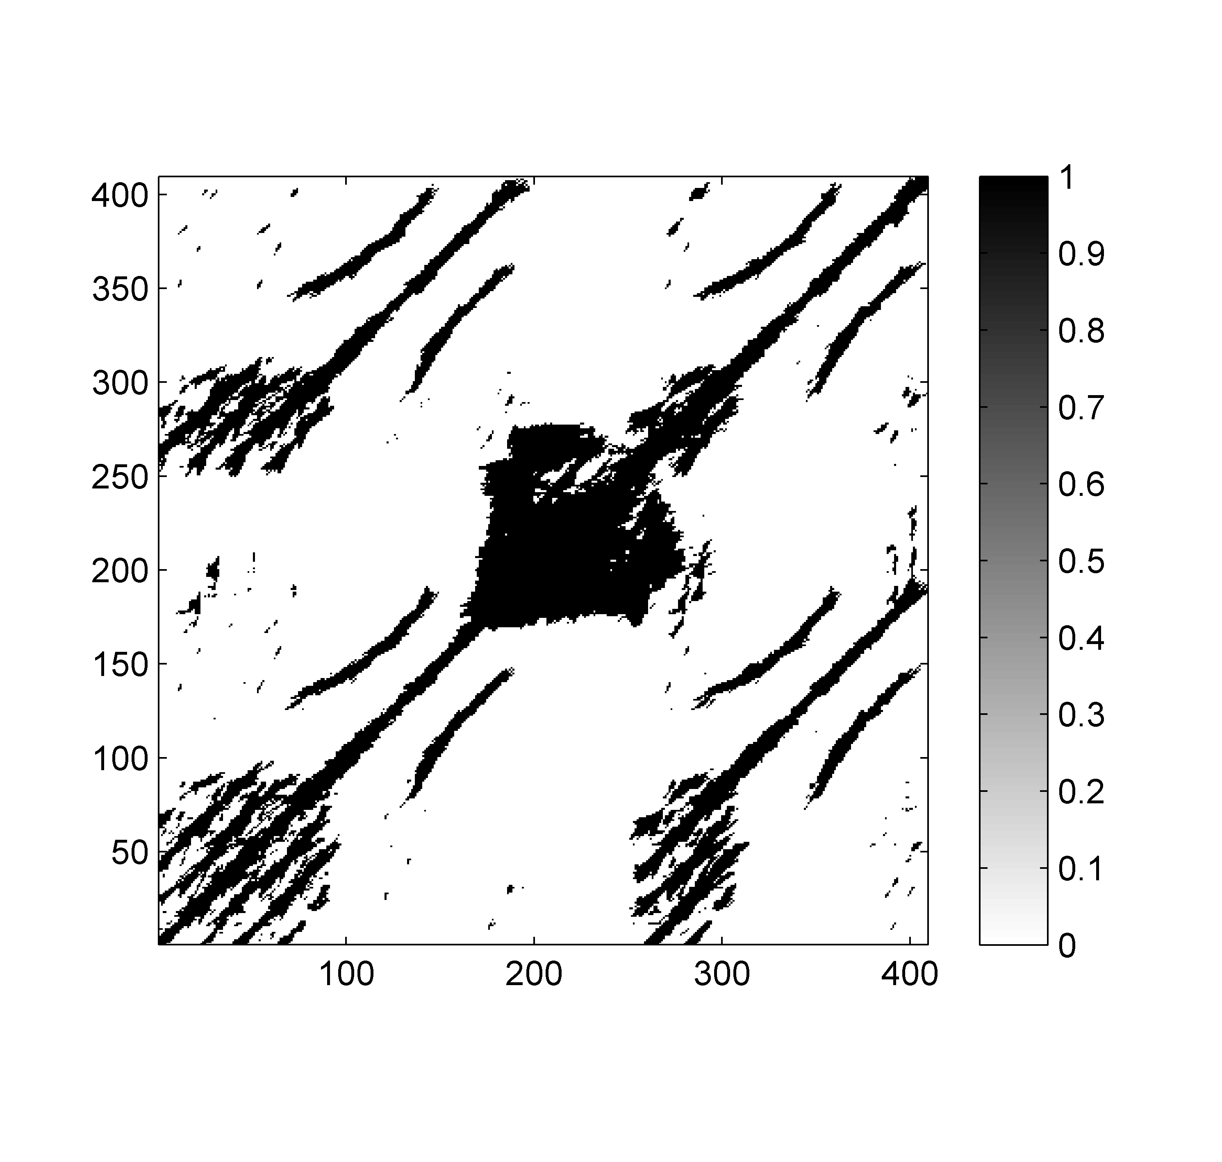
4.2 Self-Similarity Matrices
Fig. 4.14
Time (samples)
Time (samples)

Slide 47
4.2 Self-Similarity Matrices
Fig. 4.14
Time (samples)
Time (samples)

Slide 48
4.2 Self-Similarity Matrices
Fig. 4.15

Slide 49
4.2 Self-Similarity Matrices
Fig. 4.15
Time (samples)
Time (samples)

Slide 50
4.2 Self-Similarity Matrices
Fig. 4.15
Time (samples)
Time (samples)

Slide 51
4.2 Self-Similarity Matrices
Fig. 4.15
Time (samples)
Time (samples)

Slide 52
4.2 Self-Similarity Matrices
Fig. 4.15
Time (samples)
Time (samples)

Slide 53
4.2 Self-Similarity Matrices
Fig. 4.15
Time (samples)
Time (samples)

Slide 54
4.2 Self-Similarity Matrices
Fig. 4.15
Time (samples)
Time (samples)

Slide 55
4.3 Audio Thumbnailing
Fig. 4.16

Slide 56
4.3 Audio Thumbnailing
Fig. 4.17

Slide 57
4.3 Audio Thumbnailing
Fig. 4.18

Slide 58
4.3 Audio Thumbnailing
Fig. 4.19

Slide 59
4.3 Audio Thumbnailing
Fig. 4.20

Slide 60
4.3 Audio Thumbnailing
Fig. 4.20
Time (seconds)
Time (seconds)

Slide 61
4.3 Audio Thumbnailing
Fig. 4.20
Time (seconds)
Time (seconds)

Slide 62
4.3 Audio Thumbnailing
Fig. 4.20
Time (seconds)
Time (seconds)

Slide 63
4.3 Audio Thumbnailing
Fig. 4.20
Time (seconds)
Time (seconds)

Slide 64
4.3 Audio Thumbnailing
Fig. 4.21

Slide 65
4.3 Audio Thumbnailing
Fig. 4.22

Slide 66
4.3 Audio Thumbnailing
Fig. 4.22
Time (seconds)

Slide 67
4.3 Audio Thumbnailing
Fig. 4.22
Time (seconds)
Time (seconds)

Slide 68
4.3 Audio Thumbnailing
Fig. 4.22
Time (seconds)
Time (seconds)

Slide 69
4.4 Novelty-Based Segmentation
Fig. 4.23

Slide 70
4.4 Novelty-Based Segmentation
Fig. 4.24

Slide 71
4.4 Novelty-Based Segmentation
Fig. 4.24

Slide 72
4.4 Novelty-Based Segmentation
Fig. 4.24

Slide 73
4.4 Novelty-Based Segmentation
Fig. 4.25

Slide 74
4.4 Novelty-Based Segmentation
Fig. 4.26

Slide 75
4.4 Novelty-Based Segmentation
Fig. 4.26

Slide 76
4.4 Novelty-Based Segmentation
Fig. 4.27

Slide 77
4.5 Evaluation
Fig. 4.28

Slide 78
4.5 Evaluation
Fig. 4.29

Slide 79
4.5 Evaluation
Fig. 4.30

Slide 80
4.5 Evaluation
Fig. 4.31

Slide 81
4.5 Evaluation
Fig. 4.32

Slide 82
4.5 Evaluation
Fig. 4.33

Slide 83
4.5 Evaluation
Fig. 4.33

Slide 84
4.5 Evaluation
Fig. 4.33

